Slide 1
Application Delivery Fundamentals 2.0 B: Java
API Design

Slide 2
API Design
Goals
Web API Design - Crafting Interfaces for Developers
Nouns are good; verbs are bad
Plural nouns and concrete names
Simplify associations - sweep complexity under the ‘?’
Handling errors
Pagination and partial response
What about responses that don’t involve resources?

Slide 3
API Design
Goals
Supporting multiple formats
What about attribute names?
Consolidate API requests in one subdomain
Authentication
Making requests on your API
Chatty APIs
The API Façade Pattern

Slide 4
Web APIs and REST
A web API is the pattern of HTTP requests and responses.
Used to access a website that is specialized for access by arbitrary computer programs.
REST is the name that has been given to the architectural style of HTTP itself, described by one of the leading authors of the HTTP specifications.
HTTP is the reality—REST is a set of design ideas that shaped it.
From a practical point of view, we can focus our attention on HTTP and how we use it to develop APIs.
The importance of REST is that it helps us understand how to think about HTTP and its use.

Slide 5
Web API Design - Crafting Interfaces for Developers
The primary design principle when crafting your API should be to maximize developer productivity and success. This is what we call pragmatic REST.
Pragmatic REST is a design problem
You have to get the design right, because design communicates how something will be used.

Slide 6
How to design or build great Web API Applications?
Basically we’re building applications (web, windows, etc...) for end users who are not programmers, who can easily use your application.
Here, they are just end users for our application but API is designed only for programmers who can consume our great API and perform whatever operations they want for their applications based on the requirement.

Slide 7
API implementation point of view
What does this service need to do?
What does this service need to provide?
How my API will act as more generic (input, output and extensible)?

Slide 8
API consumer point of view:
How can consumers assuredly integrate with our API?
How nimbly, they can provide input to us and output for their use from our API?
How can consumers spend the bare minimum of effort to get what they need out of this API?

Slide 9
Guidelines for designing a great Web API
1. Documentation (swagger/swash buckle)
2. Naming Conventions for Controllers and Actions
3. Don’t change the state of HTTP Methods
4. Stability and Consistency
5. Flexibility
6. Security
7. Validation
8. HTTP Status Codes
9. Web API Helper page
10. Logging

Slide 10
Documentation:
Documentation is very important for Web API’s because in this, each method is describing two things i.e., what it’ll accept and what it’ll provide.
As a developer, I worked on consuming several external web API’s like mail chimp, klaviyo, sales force, bronto and etc. these all are email service providers.
My Requirement is to get a list of emails from each web API.
I have many API's to go through and it needs to integrate each of them.
If each API will take only a minimum amount of time to understand what API is doing and how I can get the result then it’s a great API because of well marked documentation.
A few API's are hell; I need to spend more time on it because of poor documentation.

Slide 11
Documentation:
Here I am thinking like an API user. So every Web API developer should think from the user's perspective too.
Although you are building great API's for end users, if they are facing a lot of difficulties or spending more time to integrate/understand it, then it’s not a great API.

Slide 12
Keep your base URL simple and intuitive
The base URL is the most important design affordance of your API.
A simple and intuitive base URL design makes using your API easy.
Affordance is a design property that communicates how something should be used without requiring documentation.
A door handle's design should communicate whether you pull or push.
Here's an example of a conflict between design affordance and documentation - not an natural interface!

Slide 13
Keep your base URL simple and intuitive

Slide 14
Keep your base URL simple and intuitive
A key litmus test we use for Web API design is that there should be only 2 base URLs per resource.
Let's model an API around a simple object or resource, a product, and create a Web API for it.
The first URL is for a collection; the second is for a specific element in the collection.
/products /products/1234
Boiling it down to this level will also force the verbs out of your base URLs.

Slide 15
Naming Conventions for Controllers and Actions
Use plural nouns for Controllers
Don’t mix up singular and plural nouns.
Keep it simple and use only plural nouns for all resources.
Example:
/products instead of /product
/users instead of /user

Slide 16
Keep verbs out of your base URLs
Many Web APIs start by using a method-driven approach to URL design.
These method-based URLs sometimes contain verbs - sometimes at the beginning, sometimes at the end.
For any resource that you model, like our dog, you can never consider one object in isolation.
Rather, there are always related and interacting resources to account for - like owners, veterinarians, leashes, food, squirrels, and so on.

Slide 17
Keep verbs out of your base URLs

Slide 18
Naming Conventions for Controllers and Actions
Use nouns but no verbs for Actions
Don’t use fully described names for actions. It’s a bad practice.
 | GET | POST | PUT | DELETE
RESOURCE | Read | Create | Update | Delete
/Products | Returns a list of products | Create a new product | Bulk update of products | Delete all products
/Products/101 | Returns a specific product | Method not allowed (405) | Updates a specific product | Deletes a specific product

Slide 19
Naming Conventions for Controllers and Actions
Don’t use verbs: /getAllProducts /createNewProduct /deleteAllProducts .

Slide 20
Naming Conventions for Controllers and Actions
Don’t change the state of HTTP Methods
HTTP methods have their own state of behavior. Don’t change or mix their state.
GET | POST | PUT | DELETE
RESOURCE | Read | Create | Update | Delete

Slide 21
Plural nouns and concrete names
Should you choose singular or plural nouns for your resource names?
Let's look at a few examples:
Foursquare GroupOn Zappos
/checkins /deals /Product
Given that the first thing most people probably do with a RESTful API is a GET, we think it reads more easily and is more intuitive to use plural nouns.
But above all, avoid a mixed model in which you use singular for some resources, plural for others.
Being consistent allows developers to predict and guess the method calls as they learn to work with your API.

Slide 22
Concrete names are better than abstract
is not always meaningful for developers.
Take for example an API that accesses content in various forms - blogs, videos, news articles, and so on.
An API that models everything at the highest level of abstraction - as /items or /assets in our example - loses the opportunity to paint a tangible picture for developers to know what they can do with this API.
It is more compelling and useful to see the resources listed as blogs, videos, and news articles.

Slide 23
Concrete names are better than abstract
The level of abstraction depends on your scenario.
You also want to expose a manageable number of resources.
Aim for concrete naming.
In summary, an intuitive API uses plural rather than singular nouns, and concrete rather than abstract names.

Slide 24
Stability and Consistency
API is more successful and it has a lot of clients.
Now, you have a requirement to rename one of the fields or add a new field for JSON response.
What happens if you modify the changes and publish a web API?
Everyone that’s already integrated with you is going to break.
In the software world, we can't blame changes or new feature requests.
They are part of the software development. We can't stop them or refuse them either.
The most common way of handling changes is, to have versions of an API.

Slide 25
Versioning
Changes that don’t break existing code using the API can be handled within one version.
If there are breaking changes i.e. it risks breaking the code which is using the API, those changes should be introduced in a new version of the API.
Every developer should do some planning ahead of your web API.
Make the API Version mandatory and never release an unversioned API.

Slide 26
Versioning
Never release an API without a version and make the version mandatory.
Let's see how three top API providers handle versioning.
Twilio /2010-04-01/Accounts/
salesforce.com /services/data/v20.0/sobjects/Account
Facebook ?v=1.0

Slide 27
Versioning
Twilio uses a timestamp in the URL (note the European format).
At compilation time, the developer includes the timestamp of the application when the code was compiled.
That timestamp goes in all the HTTP requests.
When a request arrives, Twilio does a look up.
Based on the timestamp they identify the API that was valid when this code was created and route accordingly.
For example, it can be confusing to understand whether the timestamp is the compilation time or the timestamp when the API was released.

Slide 28
Versioning
Salesforce.com uses v20.0, placed somewhere in the middle of the URL.
We like the use of the v. notation.
However, we don't like using the .0 because it implies that the interface might be changing more frequently than it should.
The logic behind an interface can change rapidly but the interface itself shouldn't change frequently.

Slide 29
Versioning
Facebook also uses the v. notation but makes the version an optional parameter.
This is problematic because as soon as Facebook forced the API up to the next version, all the apps that didn't include the version number broke and had to be pulled back and version number added.

Slide 30
How to think about version numbers in a pragmatic way with REST?
Never release an API without a version. Make the version mandatory.
Specify the version with a 'v' prefix. Move it all the way to the left in the URL so that it has the highest scope (e.g. /v1/products).
Use a simple ordinal number.
Don't use the dot notation like v1.2 because it implies a granularity of versioning that doesn't work well with APIs--it's an interface not an implementation.
Stick with v1, v2, and so on.

Slide 31
How to think about version numbers in a pragmatic way with REST?
How many versions should you maintain? Maintain at least one version back.
For how long should you maintain a version? Give developers at least one cycle to react before obsoleting a version.
Sometimes that's 6 months; sometimes it’s 2 years.
It depends on your developers' development platform, application type, and application users.
For example, mobile apps take longer to rev’ than Web apps

Slide 32
Should version and format be in URLs or headers?
There is a strong school of thought about putting format and version in the header.
Simple rules we follow:
If it changes the logic you write to handle the response, put it in the URL so you can see it easily.
If it doesn't change the logic for each response, like OAuth information, put it in the header

Slide 33
Should version and format be in URLs or headers?
These for example, all represent the same resource:
products/1
Content-Type: application/json
products/1
Content-Type: application/xml
products/1
Content-Type: application/png
The code we would write to handle the responses would be very different.

Slide 34
Versioning
Sample of URL version schema: /api/v1/products /api/products?version=v1 /api/products?api-version=1
/api/v2-Alpha/products /api/products?api-version=2-Alpha
/api/v2015-05-01.3.0/products /api/products?api-version=2015-05-01.3.0

Slide 35
Flexibility
Flexibility is most important for Web API’s.
Let’s say, if you have a lot of users for your web API, users may needed output as JSON format or XML format as per their business needs.
So, you can’t say that my API will always return output as JSON.
If you say that, you’ll lose your business.
How will you manage that?
How should your API act flexible (about input, output)?

Slide 36
Flexibility
5.1) Flexibility on Input:
By default, Web API will support multiple formats of input types. Those are text/html, Json, XML, etc.
5.2) Flexibility on Output:
The below formats are giving flexibility to end users to choose their output format.
Example Resources:
/api/v1/products.Json
/api/v1/products.XML
/api/v1/products/?format=Json
/api/v1/products?format=XML

Slide 37
Flexibility
5.3) Flexibility on Filtering:
Use a unique query parameter for all fields or a query language for filtering.
GET /api/v1/products?price>1000 Returns a list of products(Id, Name, Description, Code, Price), which price is greater than 1000
GET /api/v1/products?code=P123 Returns a list of products(Id, Name, Description, Code, Price) which code is "P123”
If you provide multiple filters, you can only return resources that match all filters.

Slide 38
Flexibility
5.4) Flexibility on Field selection:
The above get request, gives a list of products along with all fields (Id, Name, Description, Code, Price).
Let’s say, your API will be consumed by multiple users.
Those users may be desktop, tablet, or mobile developers. Desktop users need all fields of products, tablet users need some fields and mobile users need only few fields.
They don’t need all attributes of a resource all the time.
So, give the API consumer the ability to choose returned fields.
This will also reduce the network traffic and speed up the usage of the API.
GET /api/v1/products?fields=name,price

Slide 39
Flexibility
5.4) Flexibility on Field selection:
The above get request, gives a list of products along with all fields (Id, Name, Description, Code, Price).
Let’s say, your API will be consumed by multiple users.
Those users may be desktop, tablet, or mobile developers. Desktop users need all fields of products, tablet users need some fields and mobile users need only few fields.
They don’t need all attributes of a resource all the time.
So, give the API consumer the ability to choose returned fields.
This will also reduce the network traffic and speed up the usage of the API.
GET /api/v1/products?fields=name,price

Slide 40
Flexibility
5.5) Pagination
Paginate your API requests to limit response results and make them easier to work with.
We use offset and count in the URL query string to paginate because it provides greater control over how you view your data.

Slide 41
Flexibility
5.5) Pagination
Make it easy for developers to paginate objects in a database
It's almost always a bad idea to return every resource in a database.
Let's look at how Facebook, Twitter, and LinkedIn handle pagination.
Facebook uses offset and limit.
Twitter uses page and rpp (records per page).
LinkedIn uses start and count
Semantically, Facebook and LinkedIn do the same thing. That is, the LinkedIn start & count is used in the same way as the Facebook offset & limit.

Slide 42
Flexibility
5.5) Pagination
To get records 50 through 75 from each system, you would use:
Facebook - offset 50 and limit 25
Twitter - page 3 and rpp 25 (records per page)
LinkedIn - start 50 and count 25
Use limit and offset
We recommend limit and offset. It is more common, well understood in leading databases, and easy for developers.
/products?limit=25&offset=50

Slide 43
Flexibility
5.5) Pagination
Metadata
We also suggest including metadata with each response that is paginated that indicated to the developer the total number of records available.
What about defaults?
My loose rule of thumb for default pagination is limit=10 with offset=0. (limit=10&offset=0)
The pagination defaults are of course dependent on your data size.
If your resources are large, you probably want to limit it to fewer than 10; if resources are small, it can make sense to choose a larger limit.

Slide 44
Partial Responses
Partial response allows you to give developers just the information they need.
Take for example a request for a tweet on the Twitter API.
You'll get much more than a typical twitter app often needs - including the name of person, the text of the tweet, a timestamp, how often the message was re-tweeted, and a lot of metadata.
Let's look at how several leading APIs handle giving developers just what they need in responses, including Google who pioneered the idea of partial response.

Slide 45
Partial Responses
LinkedIn
/people:(id,first-name,last-name,industry)
This request on a person returns the ID, first name, last name, and the industry.
Facebook
/joe.smith/friends?fields=id,name,picture
Google
?fields=title,media:group(media:thumbnail)
Google and Facebook have a similar approach, which works well.
They each have an optional parameter called fields after which you put the names of fields you want to be returned.

Slide 46
Partial Responses
Add optional fields in a comma-delimited list
The Google approach works extremely well.
Here's how to get just the information we need from our products API using this approach:
/products?fields=name,color,price
It's simple to read; a developer can select just the information an app needs at a given time; it cuts down on bandwidth issues, which is important for mobile apps.

Slide 47
What about responses that don’t involve resources?
API calls that send a response that's not a resource per se are not uncommon depending on the domain.
Actions like the following are your clue that you might not be dealing with a "resource" response.
Calculate
Translate
Convert
For example, you want to make a simple algorithmic calculation like how much tax someone should pay, or do a natural language translation (one language in request; another in response), or convert one currency to another.
None involve resources returned from a database.

Slide 48
What about responses that don’t involve resources?
Use verbs not nouns
For example, an API to convert 100 euros to Chinese Yen:
/convert?from=EUR&to=CNY&amount=100
Make it clear in your API documentation that these “non-resource” scenarios are different.
Simply separate out a section of documentation that makes it clear that you use verbs in cases like this – where some action is taken to generate or calculate the response, rather than returning a resource directly.

Slide 49
Flexibility
5.6) Sorting:
Allow ascending and descending sorting over multiple fields.
GET /api/v1/products?sort=-price
- Retrieves a list of products in descending order of price
GET /api/v1/products?sort=+price,name
Retrieves a list of products in ascending order of price and name

Slide 50
Simplify associations - sweep complexity under the ‘?’
Associations Resources almost always have relationships to other resources.
What's a simple way to express these relationships in a Web API?
Let's look again at the API we modeled in nouns are good, verbs are bad - the API that interacts with our products resource.
Remember, we had two base URLs: /products and products/1234.

Slide 51
Simplify associations - sweep complexity under the ‘?’
We're using HTTP verbs to operate on the resources and collections.
Our products belong to categories.
To get all the products belonging to a specific category, or to create a new product for that category, do a GET or a POST:
GET /categories/5678/products
POST /categories/5678/products

Slide 52
Simplify associations - sweep complexity under the ‘?’
Now, the relationships can be complex.
Categories have relationships with suppliers, who have relationships with products, who have relationships with brand, and so on.
It's not uncommon to see people string these together making a URL 5 or 6 levels deep.
Remember that once you have the primary key for one level, you usually don't need to include the levels above because you've already got your specific object.
In other words, you shouldn't need too many cases where a URL is deeper than what we have above /resource/identifier/resource.

Slide 53
Sweep complexity behind the ‘?’
Most APIs have intricacies beyond the base level of a resource.
Complexities can include many states that can be updated, changed, queried, as well as the attributes associated with a resource.
Make it simple for developers to use the base URL by putting optional states and attributes behind the HTTP question mark.
To get all Citi Products available in US:
GET /products?bank=citi&state=running&location=NJ
In summary, keep your API intuitive by simplifying the associations between resources, and sweeping parameters and other complexities under the rug of the HTTP question mark.

Slide 54
Handling errors
Why is good error design especially important for API designers?
From the perspective of the developer consuming your Web API, everything at the other side of that interface is a black box.
Errors therefore become a key tool providing context and visibility into how to use an API.
First, developers learn to write code through errors.
The "test-first" concepts of the extreme programming model and the more recent "test driven development" models represent a body of best practices that have evolved because this is such an important and natural way for developers to work.

Slide 55
Handling errors
Secondly, in addition to when they're developing their applications, developers depend on well-designed errors at the critical times when they are troubleshooting and resolving issues after the applications they've built using your API are in the hands of their users.

Slide 56
Handling errors
How to think about errors in a pragmatic way with REST?
Let's take a look at how three top APIs approach it.
Facebook
HTTP Status Code: 200
{"type" : "OauthException", "message":"(#803) Some of the aliases you requested do not exist: foo.bar"}

Slide 57
Handling errors
Twilio
HTTP Status Code: 401
{"status" : "401", "message":"Authenticate","code": 20003, "more info": "http://www.twilio.com/docs/errors/20003"}
SimpleGeo
HTTP Status Code: 401
{"code" : 401, "message": "Authentication Required"}
SimpleGeo SimpleGeo provides error codes but with no additional value in the payload.

Slide 58
A couple of best practices
Use HTTP status codes Use HTTP status codes and try to map them cleanly to relevant standard-based codes.
There are over 70 HTTP status codes.
However, most developers don't have all 70 memorized.
So if you choose status codes that are not very common you will force application developers away from building their apps and over to Wikipedia to figure out what you're trying to tell them.

Slide 59
A couple of best practices

Slide 60
How many status codes should you use for your API?
When you boil it down, there are really only 3 outcomes in the interaction between an app and an API:
Everything worked - success
The application did something wrong – client error
The API did something wrong – server error

Slide 61
How many status codes should you use for your API?
Start by using the following 3 codes. If you need more, add them. But you shouldn't need to go beyond 8.
200 - OK
400 - Bad Request
500 - Internal Server Error
If you're not comfortable reducing all your error conditions to these 3, try picking among these additional 5:
201 - Created
304 - Not Modified
404 – Not Found
401 - Unauthorized
403 - Forbidden

Slide 62
Make messages returned in the payload as verbose as possible
Code for code
200 – OK 401 – Unauthorized
Message for people
{"developerMessage" : "Verbose, plain language description of the problem for the app developer with hints about how to fix it.", "userMessage":"Pass this message on to the app user if needed.", "errorCode" : 12345, "more info": "http://dev.teachdogrest.com/errors/12345"}

Slide 63
Supporting multiple formats
We recommend that you support more than one format - that you push things out in one format and accept as many formats as necessary.
You can usually automate the mapping from format to format.
Here's what the syntax looks like for a few key APIs.
Google Data?alt=json
Foursquare/venue.json
Digg*
Accept: application/json ?type=json

Slide 64
What about attribute names?
Here are API responses from a few leading APIs:
Twitter "created_at": "Thu Nov 03 05:19;38 +0000 2011"
Bing "DateTime": "2011-10-29T09:35:00Z"
Foursquare "createdAt": 1320296464
They each use a different code convention.
Foursquare has the best approach

Slide 65
What about attribute names?
Recommendations
Use JSON as default
Follow JavaScript conventions for naming attributes
- Use medial capitalization (aka CamelCase) - Use uppercase or lowercase depending on type of object
This results in code that looks like the following, allowing the JavaScript developer to write it in a way that makes sense for JavaScript.
"createdAt": 1320296464
timing = myObject.createdAt;

Slide 66
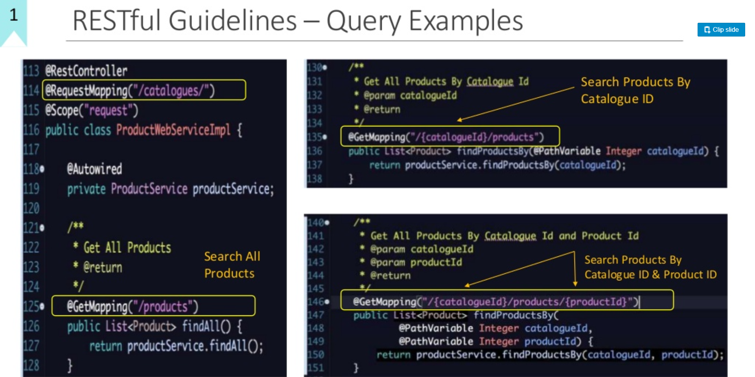

Slide 67
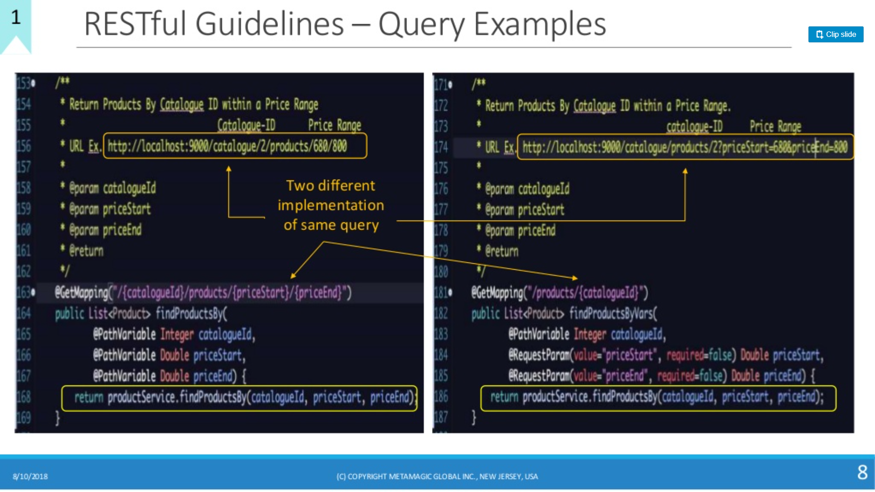

Slide 68
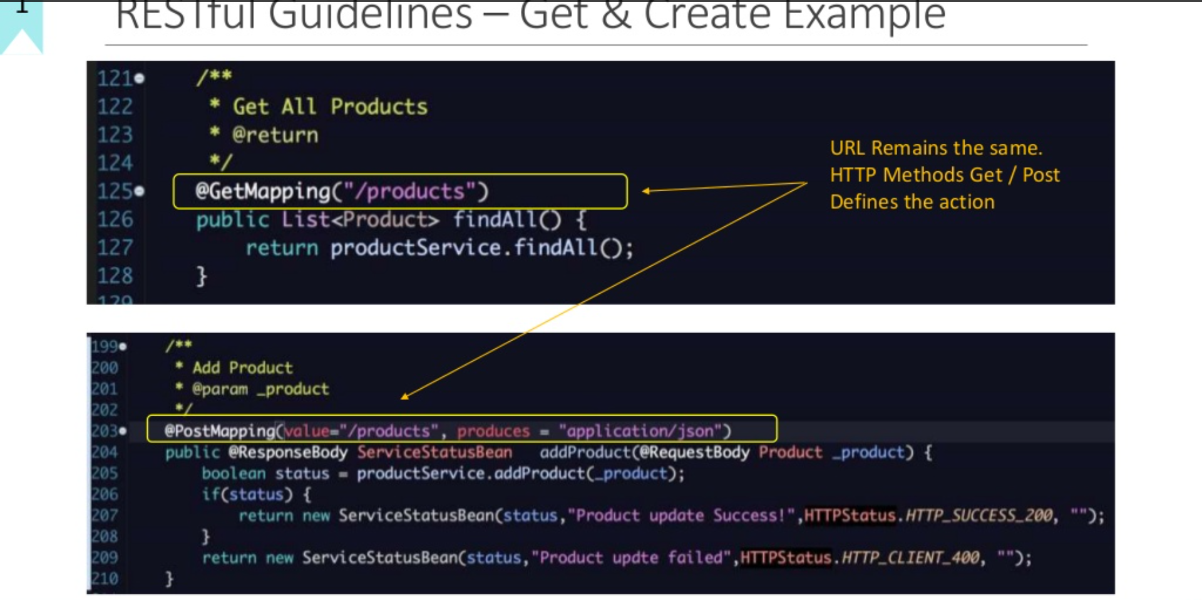

Slide 69
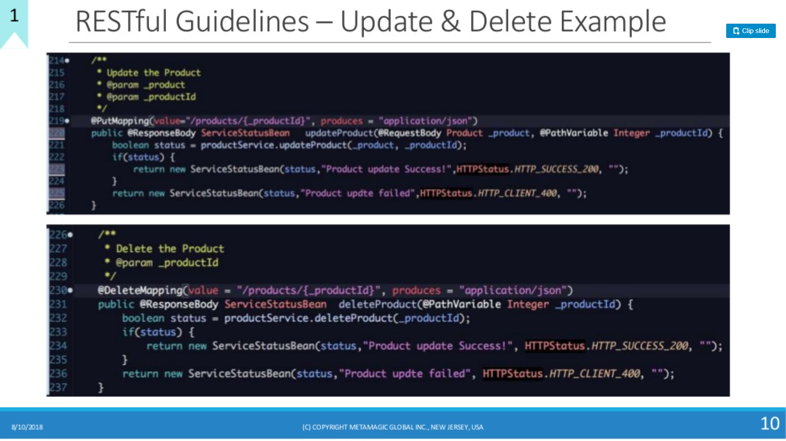

Slide 70
Security
There are different types of authentication in web API.
Token-based authentication, where the token is a random hash assigned to the user and they can reset it at any point if it has been stolen.
Allow the token to be passed in through POST or an HTTP header.
OAuth 2:
OAuth is a protocol which provides implementations of both OAuth 1 and OAuth 2 and it's used to secure a java Web API.

Slide 71
Security
OAuth flow starts where the registered user will present username and password to a specific end point.
API will validate those credentials, and if everything is valid, it will return a token for the user where the client application used by the user should store it securely and locally in order to present this token with each request to any protected end point.

Slide 72
Security
Token Generation:
Choose a secure token, not a short numeric identifier or random string. Something irreversible is best.
Generate token by using JWT. JWT is lightweight and it has pay load. You can choose algorithm type.
Generate token by using SHA1 algorithm.
Finally, if user is authenticated they can access the methods, if not it returns 401 unauthorized http code

Slide 73
Authentication
Let’s take three top services.
How each of these services handles things differently:
PayPal Permissions Service API
Facebook OAuth 2.0
Twitter OAuth 1.0a
Note that PayPal's proprietary three-legged permissions API was in place long before OAuth was conceived

Slide 74
API Validation
Invalid response codes
Invalid response headers
API time-outs
Slow API response with respect to response data bytes
Incorrect required data in JSON responses
Missing required text in response bodies
Slow response for customers in specific locations

Slide 75
Chatty API
Some API designs become very chatty - meaning just to build a simple UI or app, you have dozens or hundreds of API calls back to the server.
The API team can sometimes decide not to deal with creating a nice, resource-oriented RESTful API, and just fall back to a mode where they create the 3 or 4 Java-style getter and setter methods they know they need to power a particular user interface.

Slide 76
Chatty API
Be complete and RESTful and provide shortcuts
What kind of shortcut? Say you know that 80% of all your apps are going to need some sort of composite response, then build the kind of request that gives them what they need.

Slide 77
Chatty API
Take advantage of the partial response syntax
What kind of shortcut? Say you know that 80% of all your apps are going to need some sort of composite response, then build the kind of request that gives them what they need.

Slide 78
The API Façade Pattern
Back-end systems of record are often too complex to expose directly to application developers.
They are stable (have been hardened over time) and dependable (they are running key aspects of you business), but they are often based on legacy technologies and not always easy to expose to Web standards like HTTP.
These systems can also have complex interdependencies and they change slowly meaning that they can’t move as quickly as the needs of mobile app developers and keep up with changing formats.

Slide 79
The API Façade Pattern
In the build-up approach, a developer exposes the core objects of a big system and puts an XML parsing layer on top.

Slide 80
The API Façade Pattern
The Standards Committee Approach
Often the internal systems are owned and managed by different people and departments with different views about how things should work.
Designing an API by a standards committee often involves creating a standards document, which defines the schema and URLs and such.
All the stakeholders build toward that common goal.

Slide 81
The API Façade Pattern
The Copy Cat Approach
We sometimes see this pattern when an organization is late to market – for example, when their close competitor has already delivered a solution.
Again, this approach can get you to version 1 quickly and you may have a built-in adoption curve if the app developers who will use your API are already familiar with your competitor’s API.

Slide 82
Solution – The API façade pattern

Slide 83
Solution – The API façade pattern
Implementing an API façade pattern involves three basic steps.
1 - Design the ideal API – design the URLs, request parameters and responses, payloads, headers, query parameters, and so on. The API design should be self-consistent.
2 - Implement the design with data stubs. This allows application developers to use your API and give you feedback even before your API is connected to internal systems.
3 - Mediate or integrate between the façade and the systems.

Slide 84
HTTP and REST: A Data-oriented Design Paradigm
A REST API focuses on the underlying entities of the problem domain it exposes, rather than a set of functions that manipulate those entities.
suppose our problem domain is tracking customers and their accounts. Primary entities we might expose would include:
The collection of known customers. Its URL might be https://customertracker.com/customers

Slide 85
HTTP and REST: A Data-oriented Design Paradigm
A REST API focuses on the underlying entities of the problem domain it exposes, rather than a set of functions that manipulate those entities.
suppose our problem domain is tracking customers and their accounts. Primary entities we might expose would include:
The collection of known customers. Its URL might be https://customertracker.com/customers
Individual customers. They each have a unique URL.

Slide 86
API Design Elements
The following aspects of API design are all important, and together they define your API:
The representations of your resources—this includes the definition of the fields in the resources (assuming your resource representations are structured, rather than streams of bytes or characters), and the links to related resources.
The use of standard (and occasionally custom) HTTP headers.
The URLs and URI templates that define the query interface of your API for locating resources based on their data.
Required behaviors by clients—for example, DNS caching behaviors, retry behaviors, tolerance of fields that were not previously present in resources, and so on.

Slide 87
Designing Representations
Representation is the technical term for the data that is returned when a web resource is retrieved by a client from a server, or sent from a client to a server.
In the REST model, a web resource has underlying state, which cannot be seen directly, and what flows between clients and servers is a representation of that state.
Users can view the representation of a resource in different formats, called media types.
In principle, all media types for the representation of a particular resource should encode the same information, just in different formats.

Slide 88
JSON
The dominant media type for resource representations in web APIs is JavaScript Object Notation (JSON).
The primary reasons for JSON’s success are probably that it is simple to understand, and it is easy to map to the programming data structures of JavaScript and other popular programming languages (Python, Ruby, Java, and so on).
It is now the de facto standard for web APIs, and you should use it.

Slide 89
JSON
While JSON is very good and very popular, it is not perfect for our purposes.
One limitation is that JSON can only represent a small number of data types (Null, Boolean, Number, String).
The most common types we have come across in web API design that are not supported by JSON are dates and times and URLs.
There are several options for dealing with this limitation—the simplest is to represent them as strings, and rely on the context to determine which strings are just strings and which are really stringified dates or URLs.

Slide 90
Keep your JSON simple
When JSON is used well, it is simple, intuitive, and largely self-explanatory.
If your JSON doesn’t look as straightforward as the example below, you may be doing something wrong.
{
“kind”: “Dog”
“name”: “Lassie”,
“furColor”: “brown”,
...
}

Slide 91
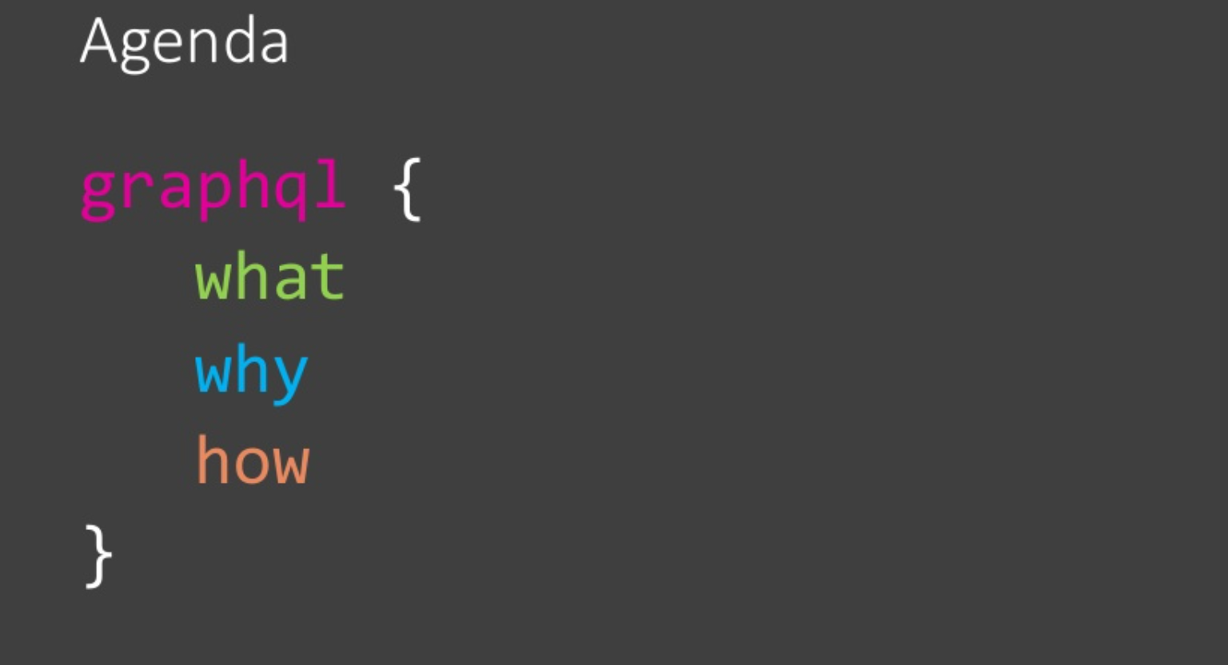
Graphql

Slide 92
GraphQL
In short, GraphQL is an open-source query language created by Facebook, a company that unsurprisingly remains at the pinnacle of web-based software development.
Before GraphQL went open source in 2015, Facebook used it internally for their mobile applications since 2012, as an alternative to the common REST architecture.
It allows requests for specific data, giving clients more control over what information is sent.

Slide 93
Client-Server flow in GraphQL
A query language like GraphQL on the server-side and client-side lets the client decide which data it needs by making a single request to the server.
Network usage was reduced dramatically for Facebook’s mobile applications as a result, because GraphQL made it more efficient with data transfers.
Facebook open-sourced the GraphQL specification and its reference implementation in JavaScript, and multiple major programming languages have implemented the specification since then.
The ecosystem around GraphQL is growing horizontally by offering multiple programming languages, but also vertically, with libraries on top of GraphQL like Apollo and Relay.

Slide 94
Client-Server flow in GraphQL
A GraphQL operation is either a query (read), mutation (write), or subscription (continuous read).
Each of those operations is only a string that needs to be constructed according to the GraphQL query language specification.

Slide 95
Who is using GraphQL?
Shopify
Twitter
Coursera
Yelp
Wordpress
The New York Times
Samsara

Slide 96
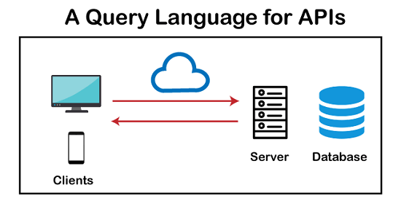
GraphQL?

Slide 97
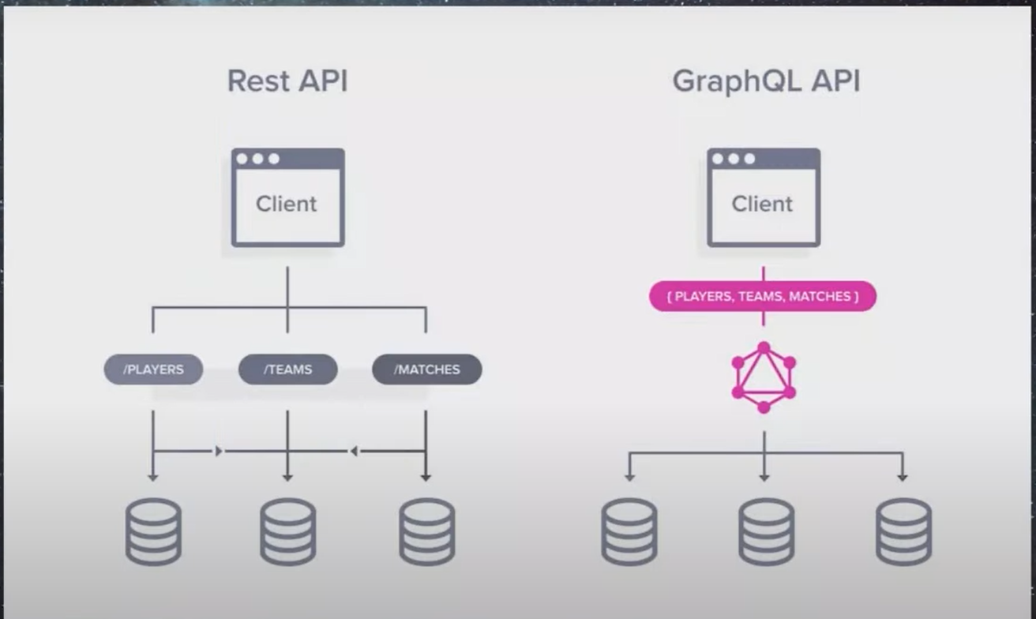
GraphQL?

Slide 98
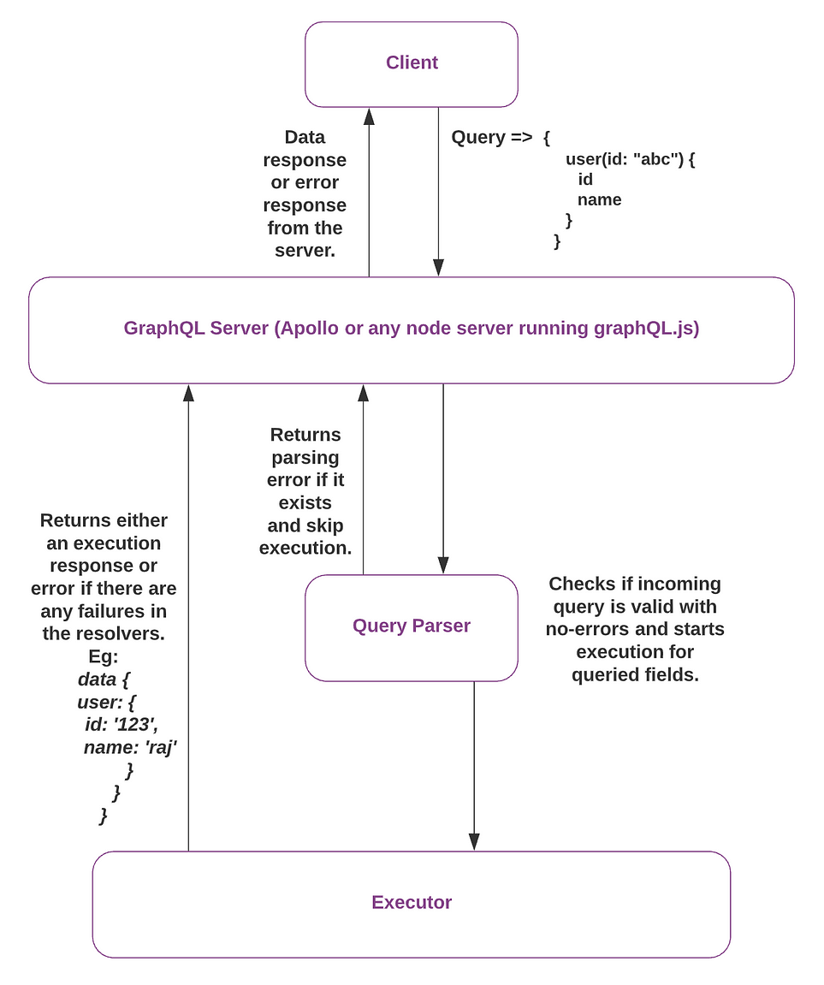
GraphQL?

Slide 99
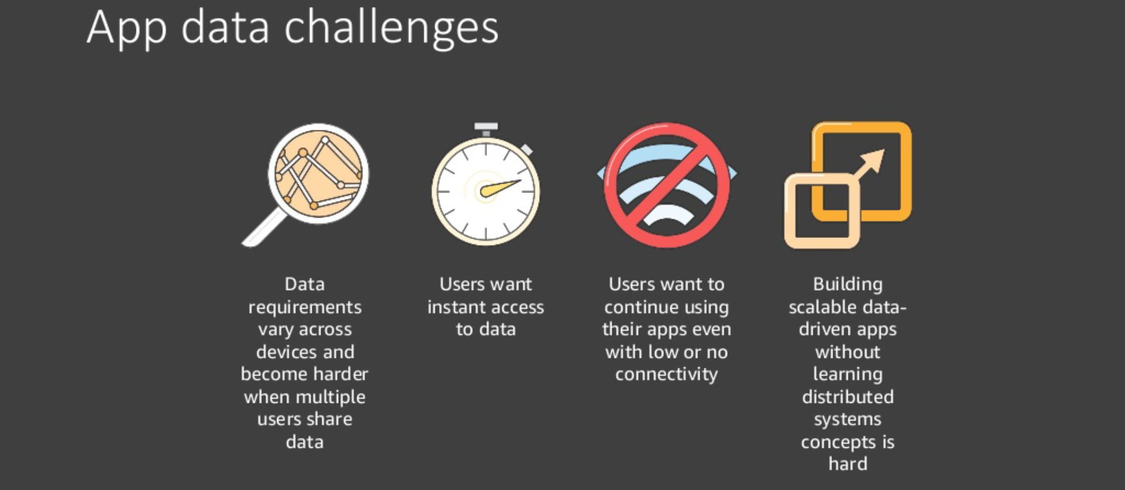
Why Graphql

Slide 100
Why Graphql called Scalable
Scalability and adaptability
A final benefit of GraphQL is that it helps you scale and adapt your website to changing requirements and user expectations.
GraphQL is designed to work with any data source, whether it is a database, a web service, a microservice, or a third-party API.
This means you can easily integrate new data sources or migrate existing ones without affecting the client.
GraphQL also gives you the flexibility to evolve your schema over time, adding new fields, types, or directives, without breaking existing queries or clients.
This way, you can keep your website up to date and relevant.

Slide 101
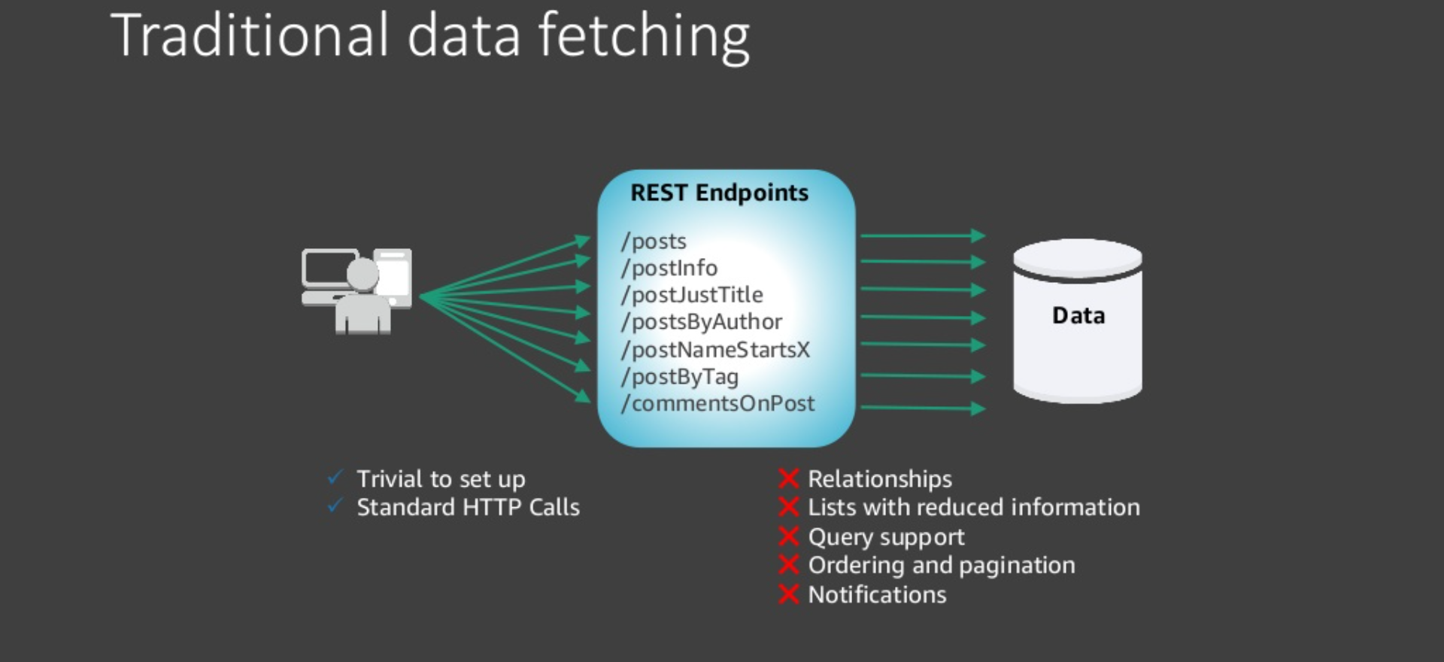
Traditional Data Fetching

Slide 102
How to build a GraphQL server?
To use GraphQL in our project, we have to build the GraphQL server. You can do it in any programming language of your choice.
There are three common architectural models for a GraphQL server.
GraphQL server with a connected database
GraphQL server integrated with the existing system.
A hybrid approach with a connected database and integration of the existing system

Slide 103
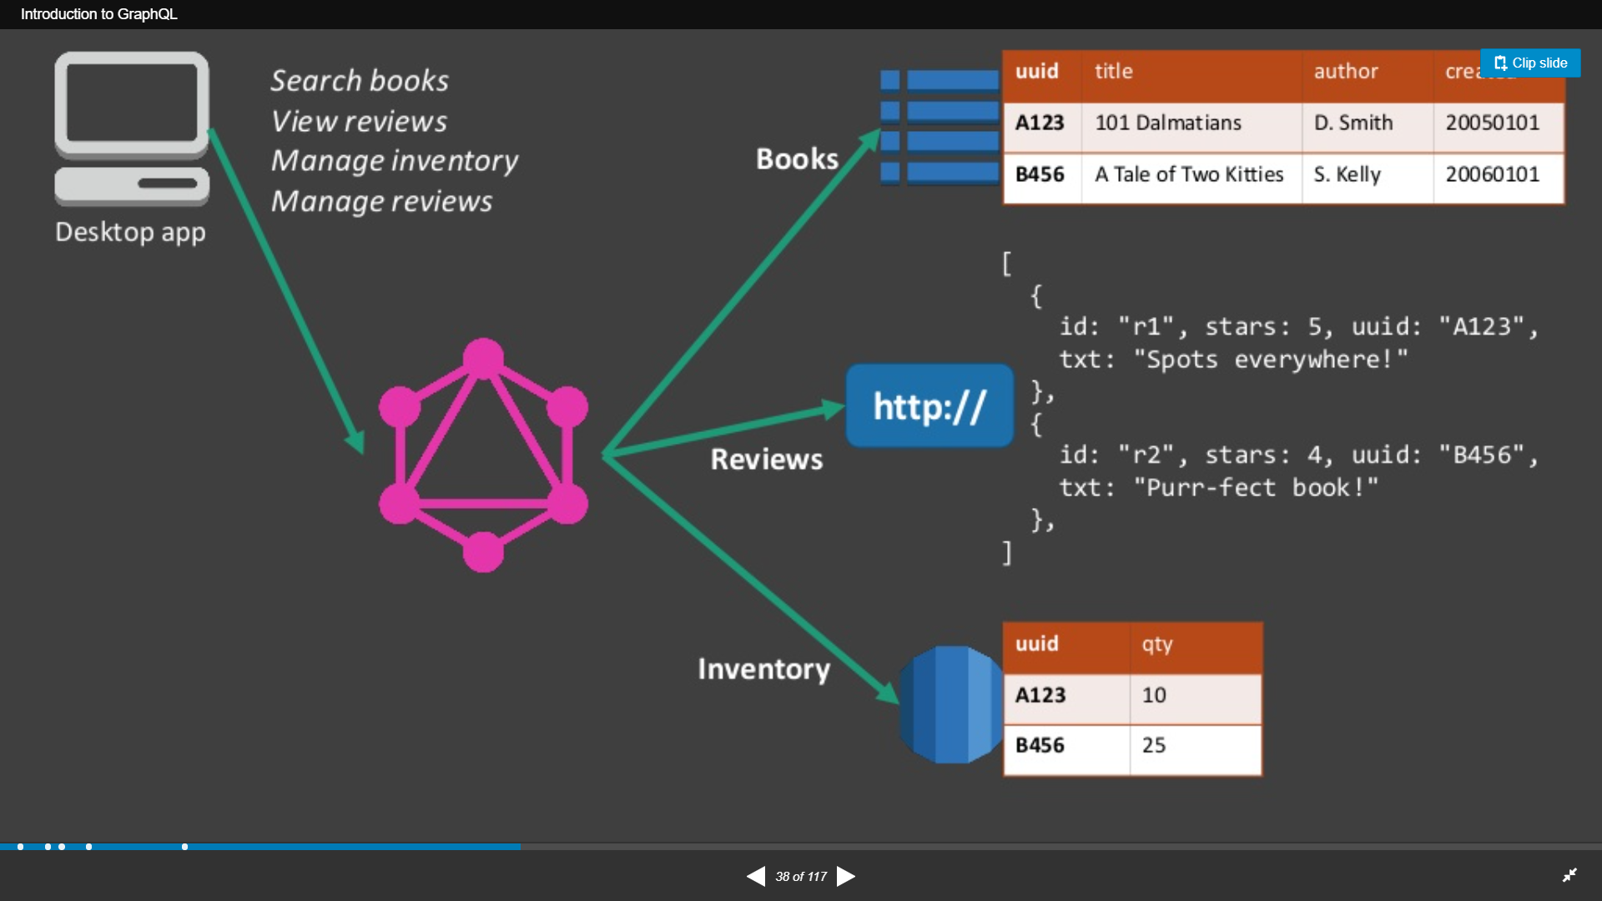
Build Graphql

Slide 104
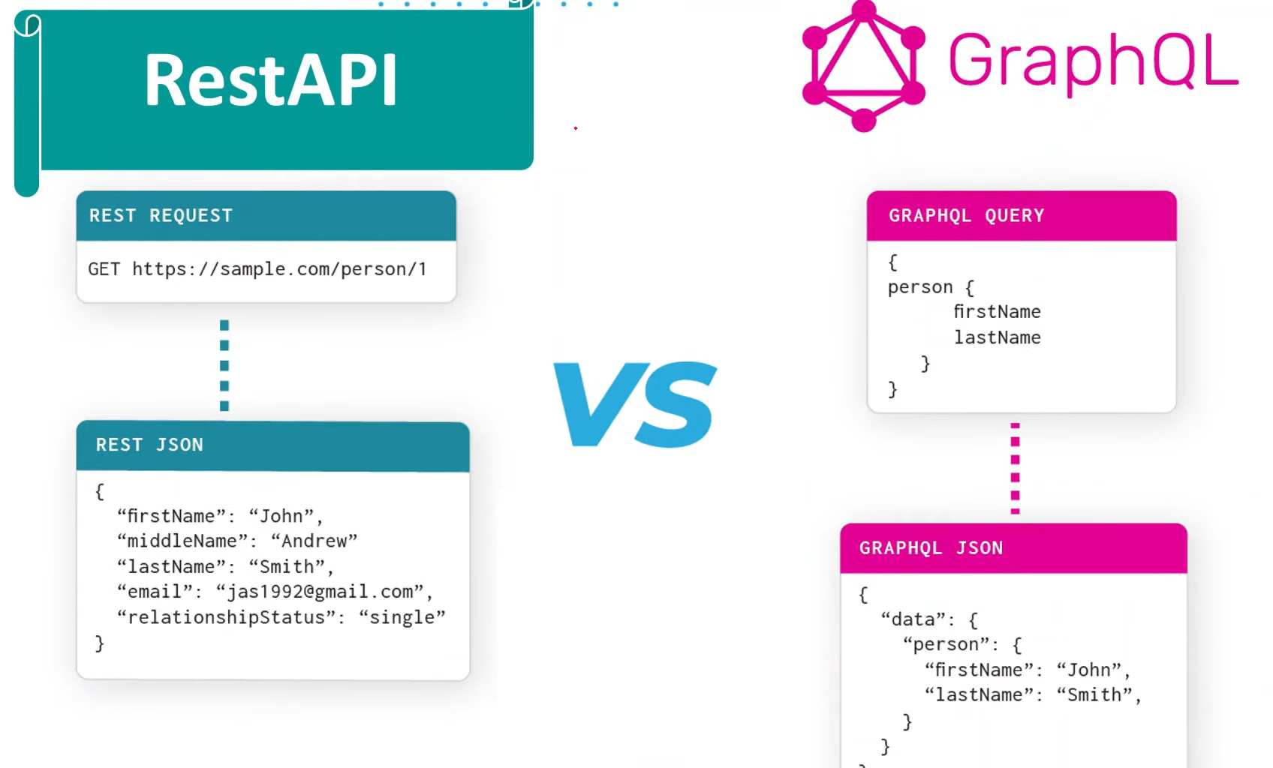
Build Graphql

Slide 105
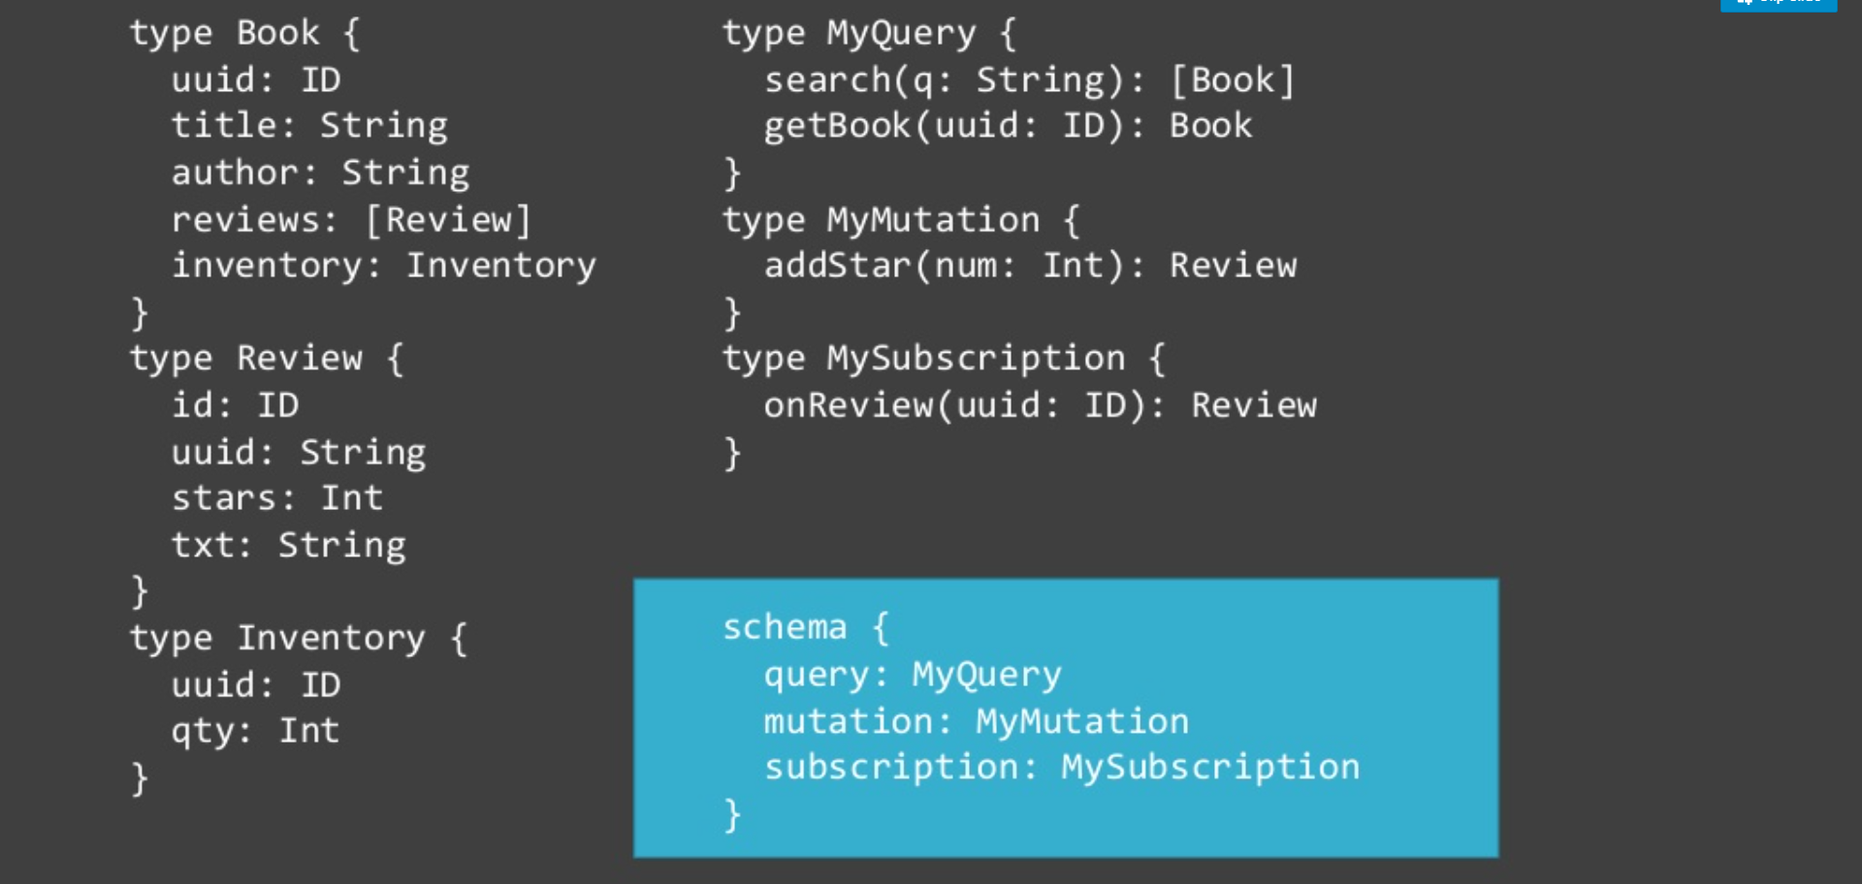
Build Graphql

Slide 106
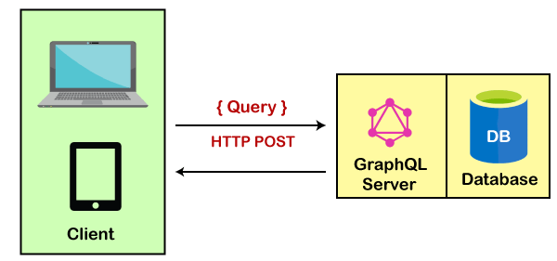
GraphQL Server with a Connected Database

Slide 107
GraphQL API development
There are two of approaches to GraphQL API development as below
Schema First API development: Here we define API with GraphQL schema file and provide service implementation for the Query/Mutation operations.
Code First API development: Its opposite to above, here GraphQL schema gets generated at run time from the code definitions.

Slide 108
Graphql Schema Types
Query Type: To define read only operations (Eg: GET)
Mutation Type: To define data alter operations (Eg: PUT, POST, DELETE, PATCH)
Input Type: To define user-defined json type used as an request parameter with Query/Mutation operations.
Output Type: To define user-defined json type used as an response type with Query/Mutation operations.
Enum Type: To define constants — can be used both for properties within input/output types.
Scalar Type: All GraphQL default primitives types are considered as scalars.
Interface Type: We can use interface type as response parameter.

Slide 109
GraphQL Server with a Connected Database
This architecture setup is mostly used for new projects.
In this architecture setup, the GraphQL server is integrated with the database.
When the client sends a query, the server reads the requested query and fetches data from the database.
This process is known as resolving the query. After resolving the query, the response is returned to the client in the official GraphQL specification format.

Slide 110
GraphQL Server with a Connected Database
In the above architecture, you can see that the GraphQL server and the database are integrated on a single node.
The client communicates with the GraphQL server by sending a query via computer/ mobile over HTTP.
After receiving the query, the GraphQL server processes the request retrieves data from the database and returns it to the client.
Key points of GraphQL Server with a Connected Database
This architecture setup is used for simple and new projects.
It uses a single web server that implements GraphQL.
This model uses resolving the query.
In this model, the server resolves the queries and constructs responses with data that it fetches from the database.

Slide 111
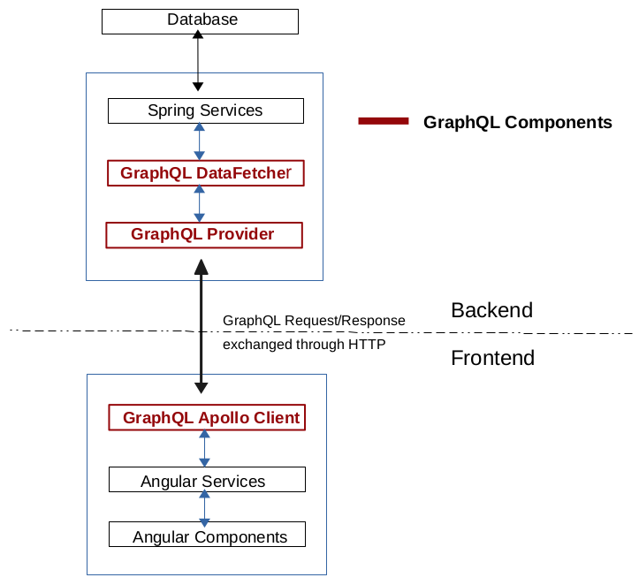
GraphQL Architectural Components

Slide 112
GraphQL Server integrated with the Existing System.
This architecture model is used for companies having complicated projects which have legacy infrastructure and many different APIs.
In this architecture model, GraphQL can be used to merge microservices, legacy infrastructure, and third-party APIs in the existing system and hide the complexity of data fetching logic.
The server doesn't care about the database you use. It may be a relational or a NoSQL database.

Slide 113
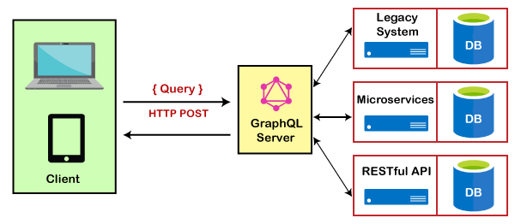
GraphQL Server integrated with the Existing System.

Slide 114
A Hybrid approach with a Connected Database and Integrated Systems
This architecture model is a combination of the above two approaches: the GraphQL server with a connected database and the GraphQL server integrated with the existing system.
In this architecture model, when a query is received by the server, the server resolves the received query and retrieves data either from the connected database or from the integrated API's.

Slide 115
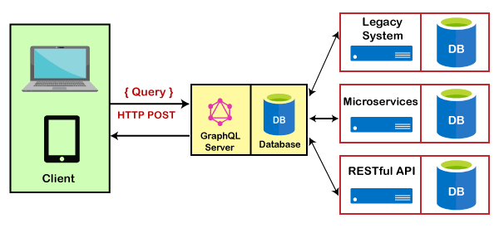
A Hybrid approach with a Connected Database and Integrated Systems

Slide 116
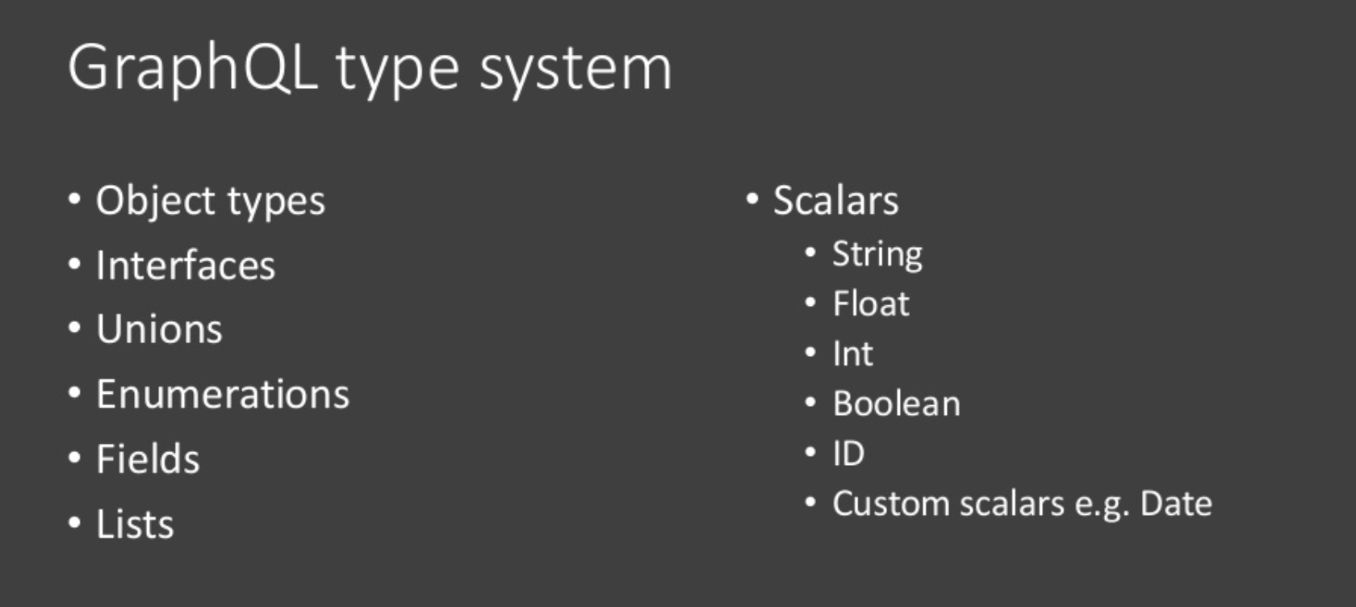
Graphql Type system

Slide 117
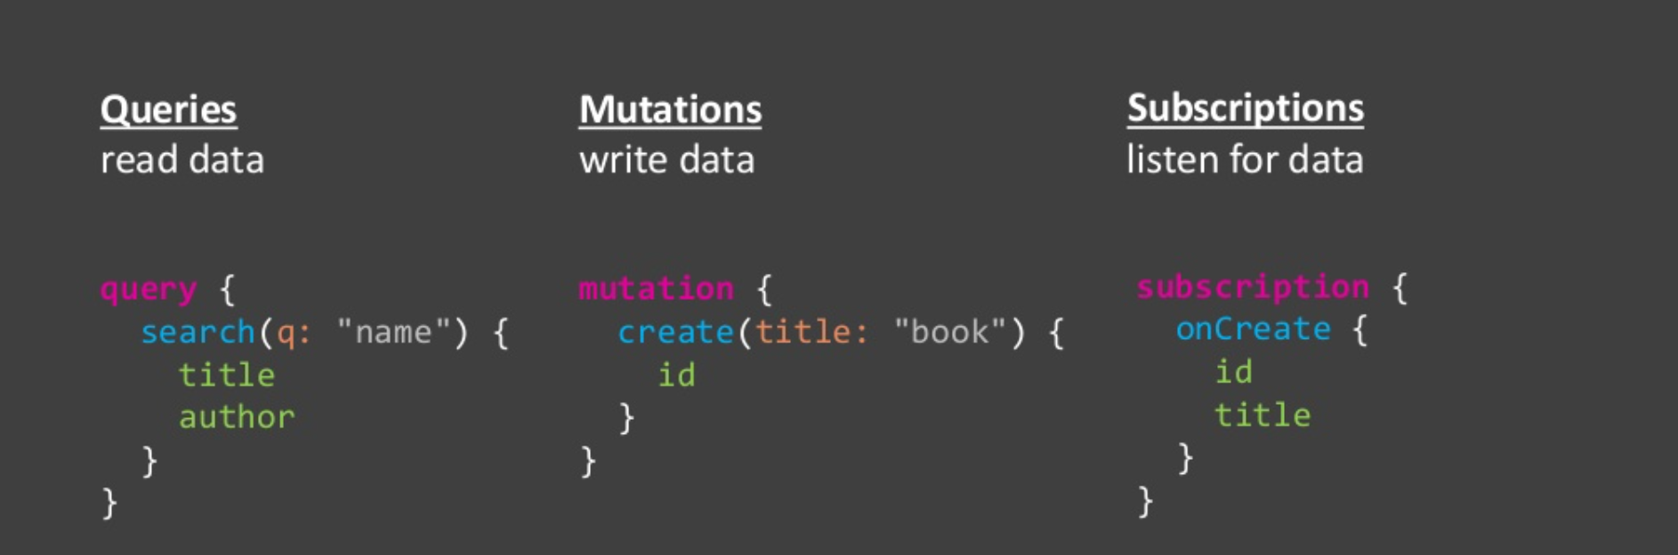
Graphql Operations

Slide 118
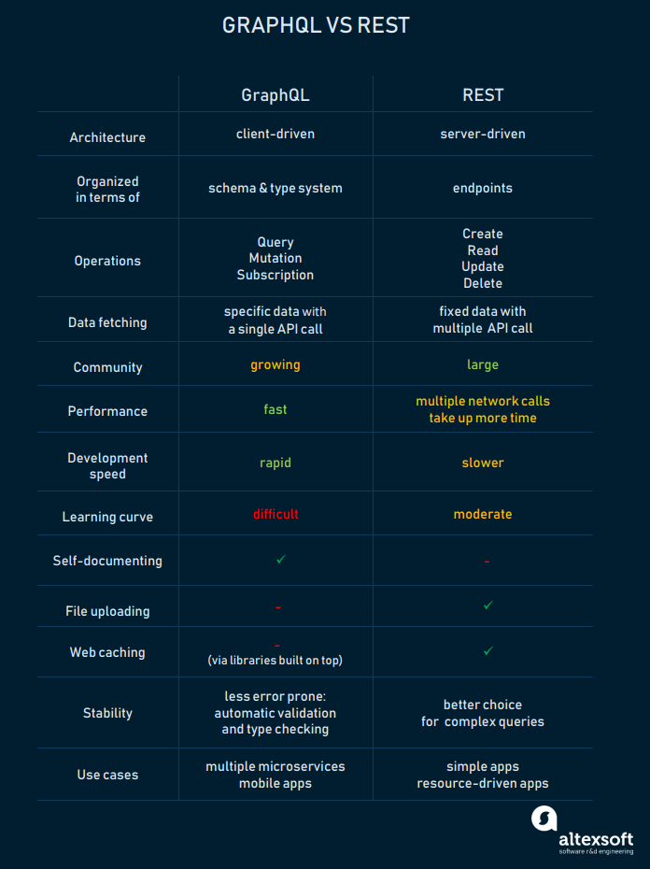
Graphql vs REST API

Slide 119
Graphql vs REST API

Slide 120
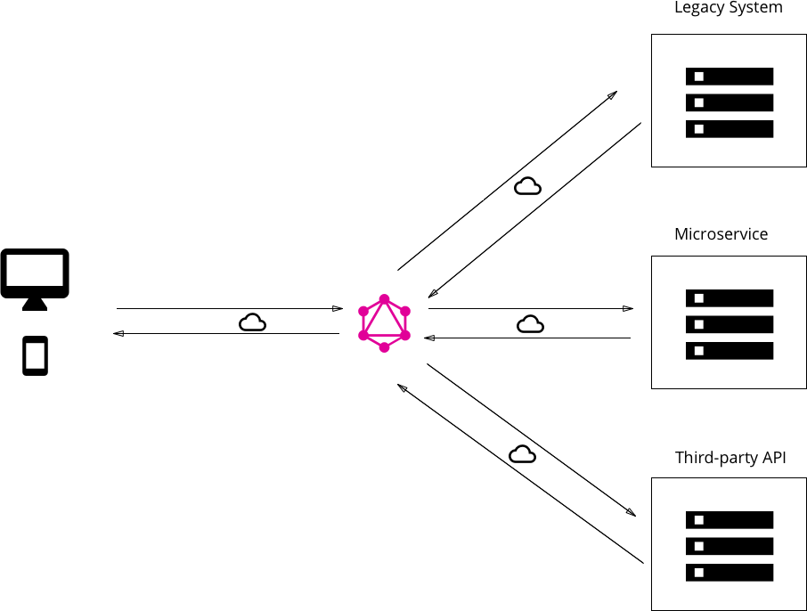
Good fit for complex systems and microservices

Slide 121
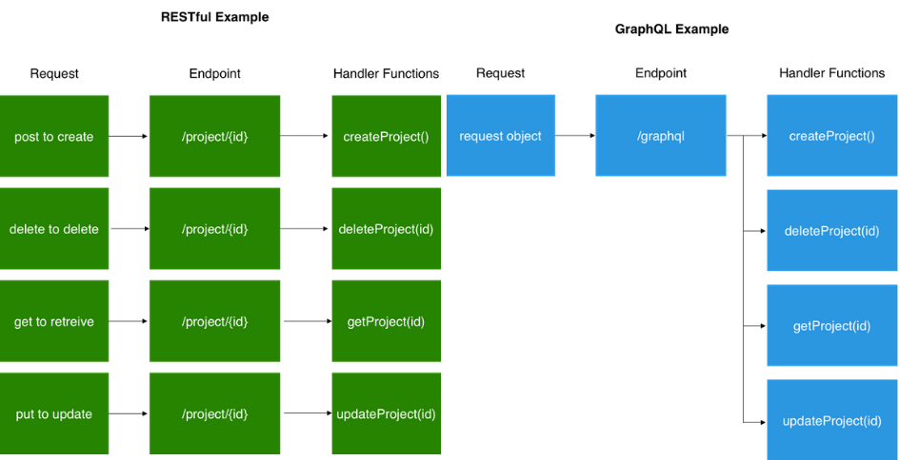
Fetching data with a single API call

Slide 122
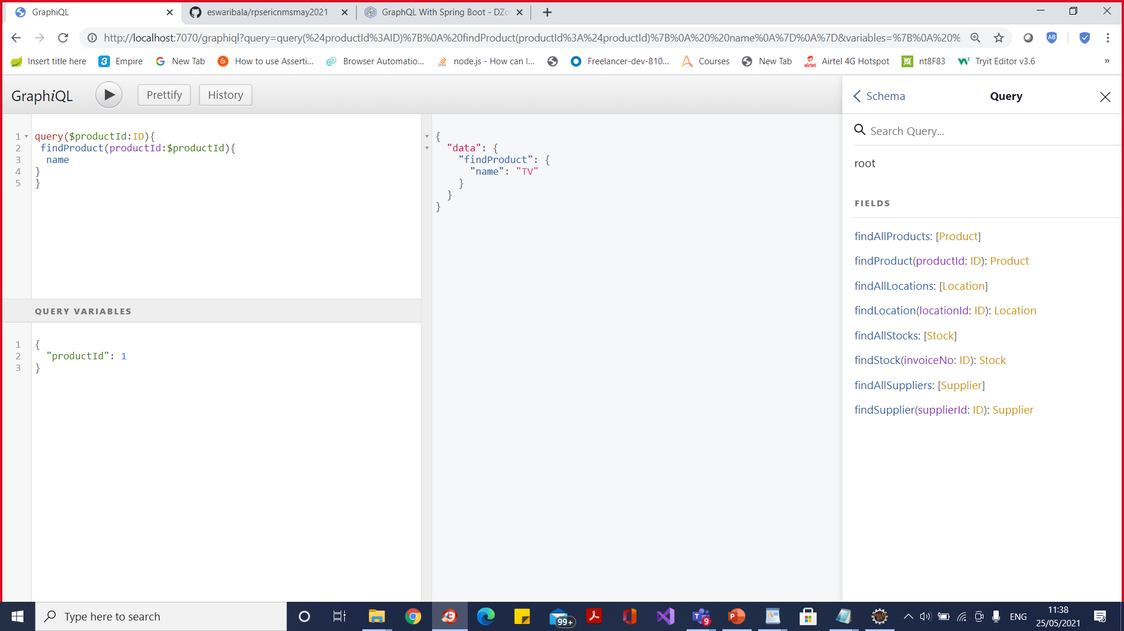

Slide 123
Union
GraphQL clients don't know which object type a field will return if the field's return type is a union.
To account for this, a query can include the subfields of multiple possible types.

Slide 124
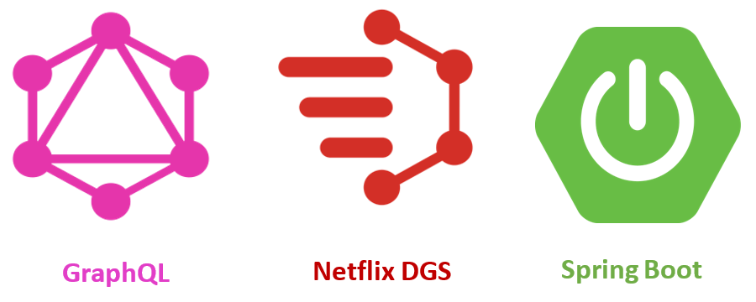
DGS Framework

Slide 125
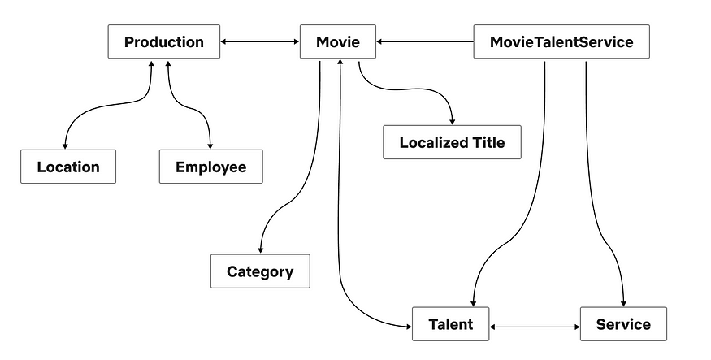
API Architecture

Slide 126
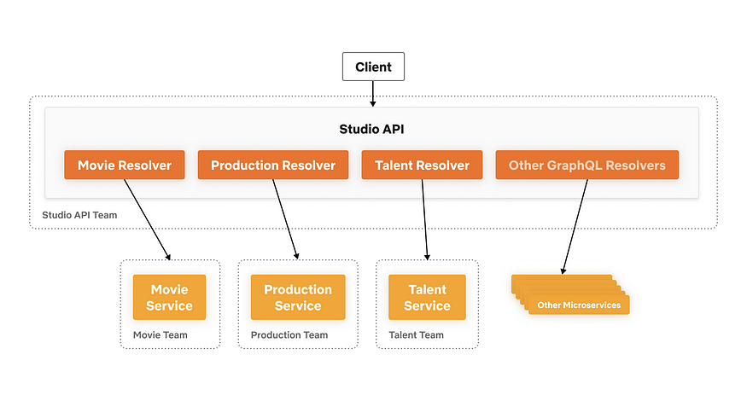
API Architecture

Slide 127
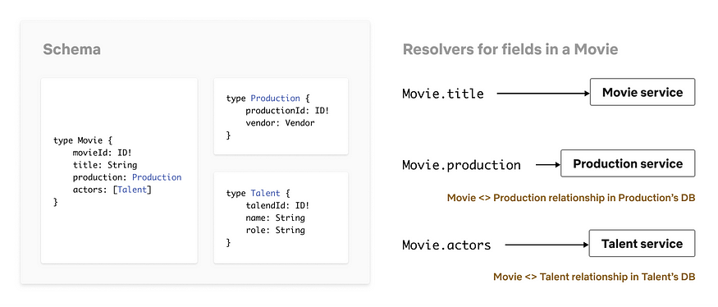
API Architecture

Slide 128
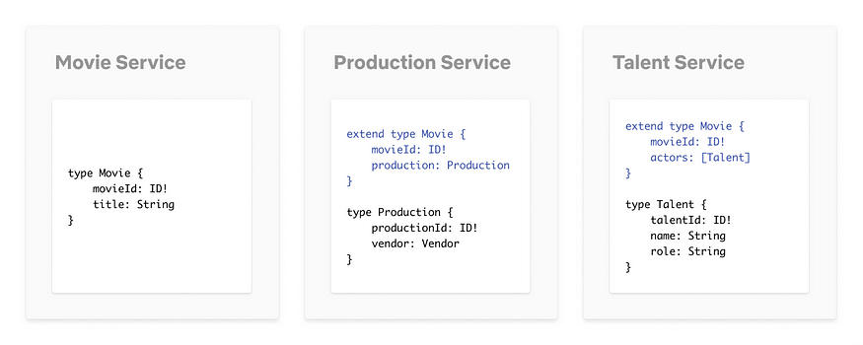
Federated Schema

Slide 129
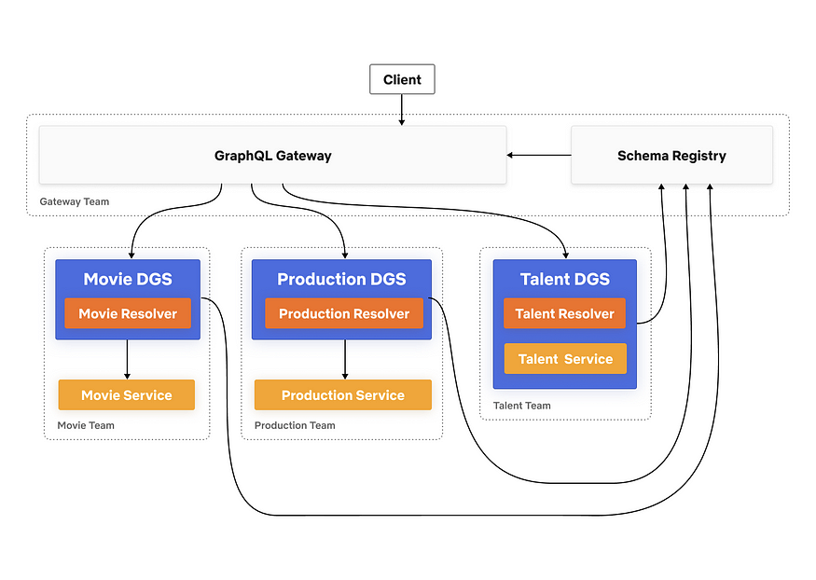
Edge Architecture

Slide 130
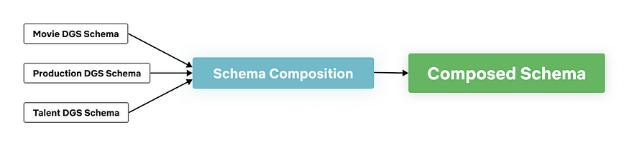
Schema Composition

Slide 131
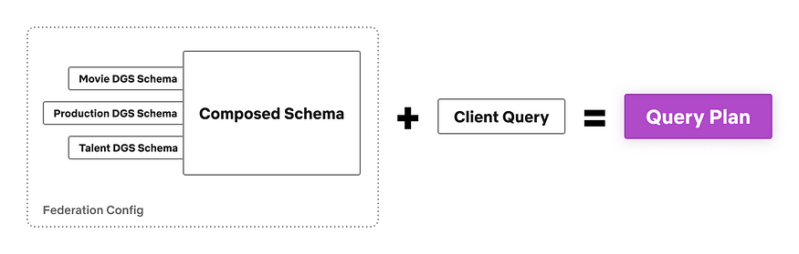
Schema Composition

Slide 132
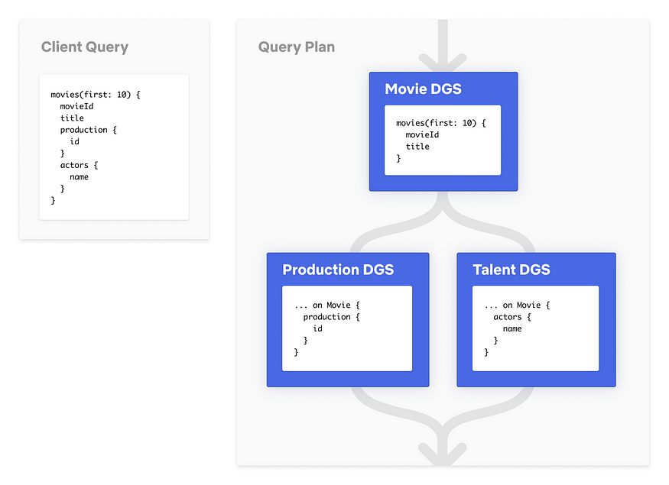
Schema Composition

Slide 133
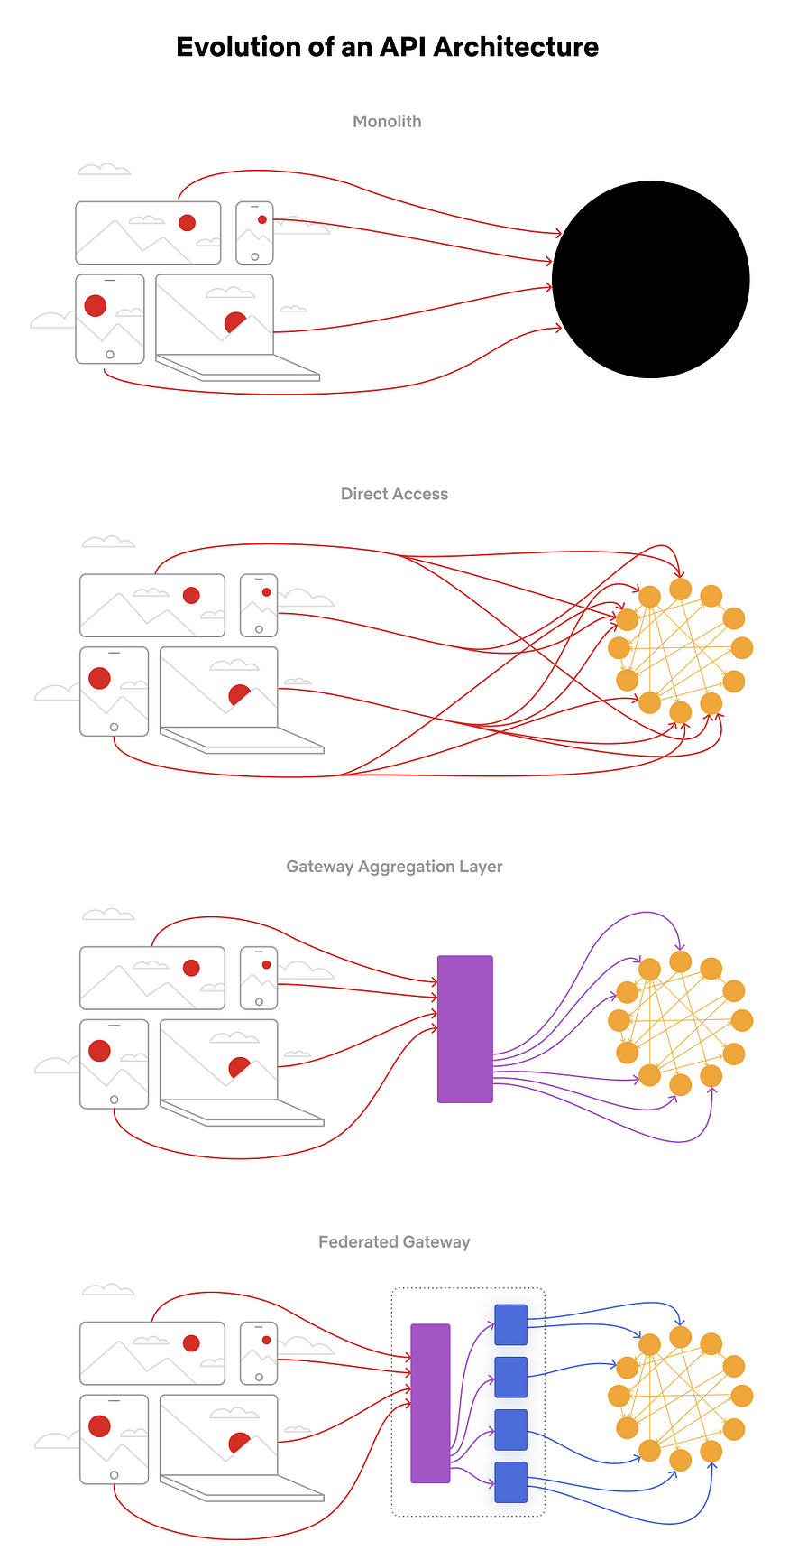
Evolution

Slide 134
Evolution

Slide 135
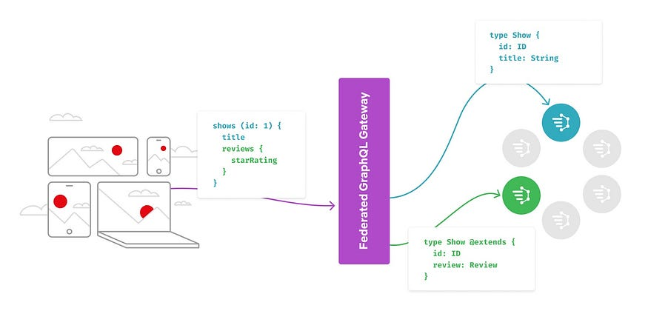
Evolution

Slide 136
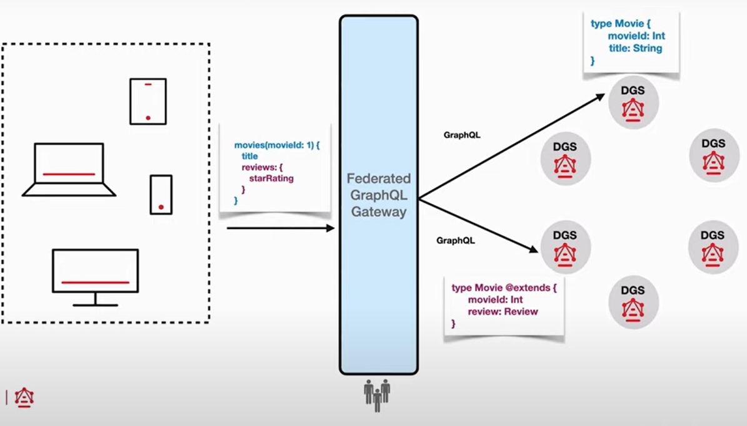
DGS Framework

Slide 137
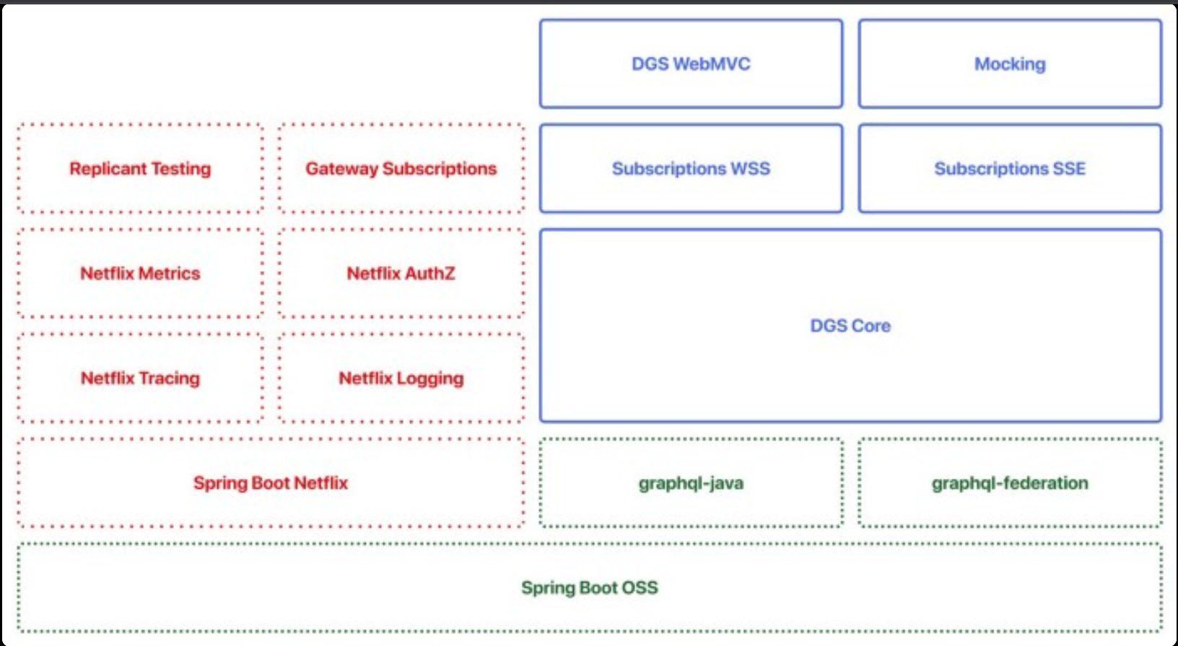
DGS Framework

Slide 138
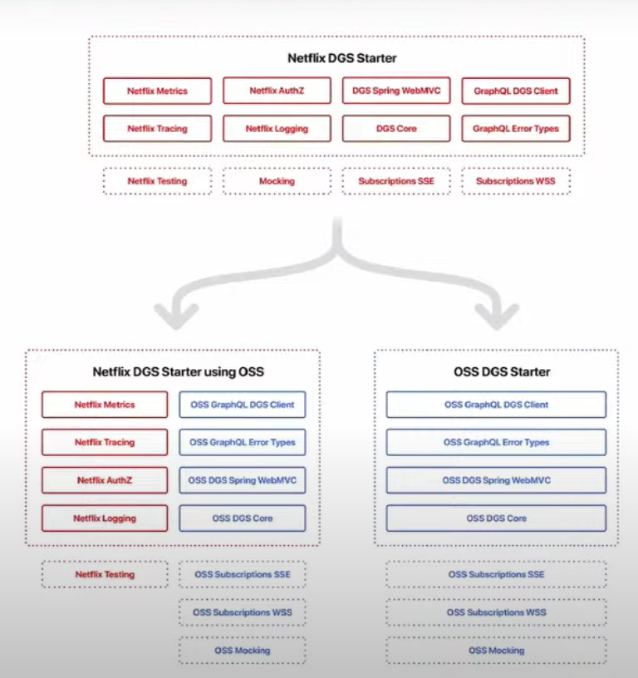
DGS Framework

Slide 139
DGS Framework
Netflix DGS (Domain Graph Service) is a GraphQL server framework written in Kotlin and based on Spring Boot.
It's designed to have minimal external dependencies aside from the Spring framework.
The Netflix DGS framework uses an annotation-based GraphQL Java library built on top of Spring Boot.

Slide 140
DGS Framework
Annotation-based Spring Boot programming model
Test framework for writing query tests as unit tests
Gradle/Maven Code Generation plugin to create types from schema
Easy integration with GraphQL Federation
Integration with Spring Security
GraphQL subscriptions (WebSockets and SSE)
File uploads
Error handling
Many extension points

Slide 141
DGS Framework Configuration
<dependency>
<groupId>com.netflix.graphql.dgs</groupId>
<artifactId>graphql-dgs-spring-boot-starter</artifactId>
<version>4.9.16</version>
</dependency>

Slide 142
DGS Framework Schema
The DGS framework supports both development approaches – schema-first and code-first.
But the recommended approach is schema-first, mainly because it's easier to keep up with changes in the data model.
Schema-first indicates that we first define the schema for the GraphQL service, and then we implement the code by matching the definitions in the schema.
The framework picks up any schema files in the src/main/resources/schema folder by default.

Slide 143
DGS Data Fetcher
@DgsQuery
@DgsMutation
@DgsSubscription

Slide 144
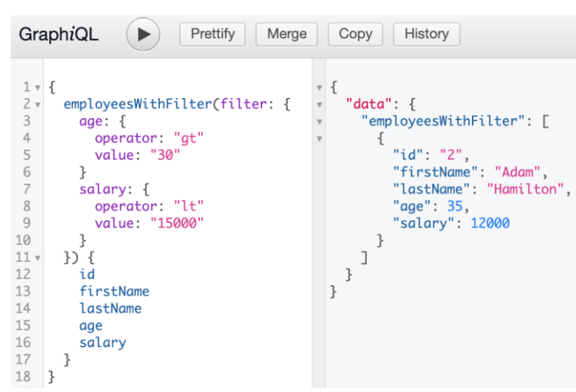
DGS Data Fetcher

Slide 145
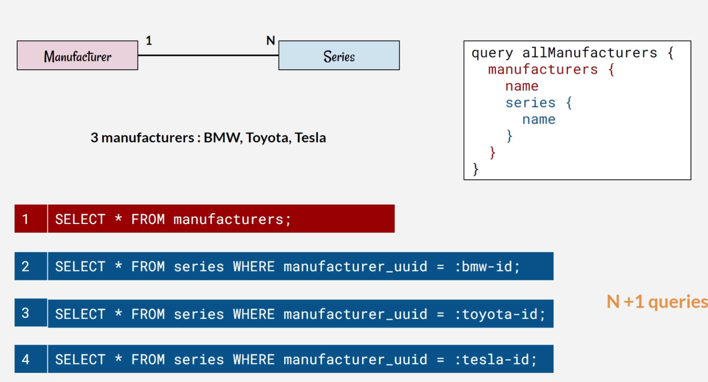
N+1 Problem

Slide 146
N+1 Problem
To illustrate the N+1 SELECT problem with an example:
If you retrieve two films, one with five actors, in English and the second film with eight actors, in Spanish, Hibernate ends up executing:
One SELECT to retrieve both films.
Two SELECT to retrieve film actors associations, one for each film.
Five SELECT to retrieve actors for the first film.
Eight SELECT to retrieve actors for the second film.
One SELECT to retrieve English language for the first film.
One last SELECT to retrieve Spanish language associated to the second film.

Slide 147
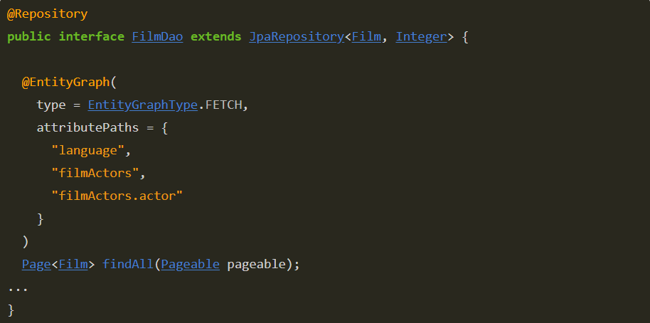
N+1 Problem

Slide 148
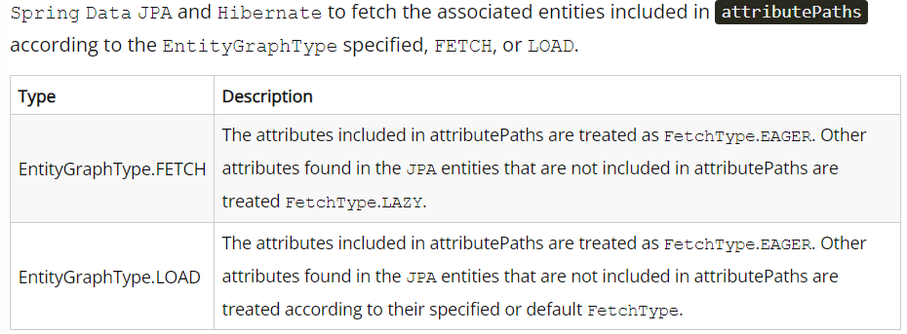
N+1 Problem

Slide 149
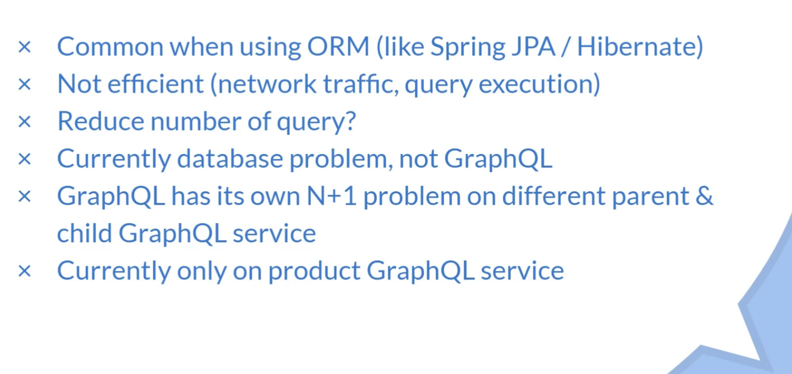
N+1 Problem

Slide 150
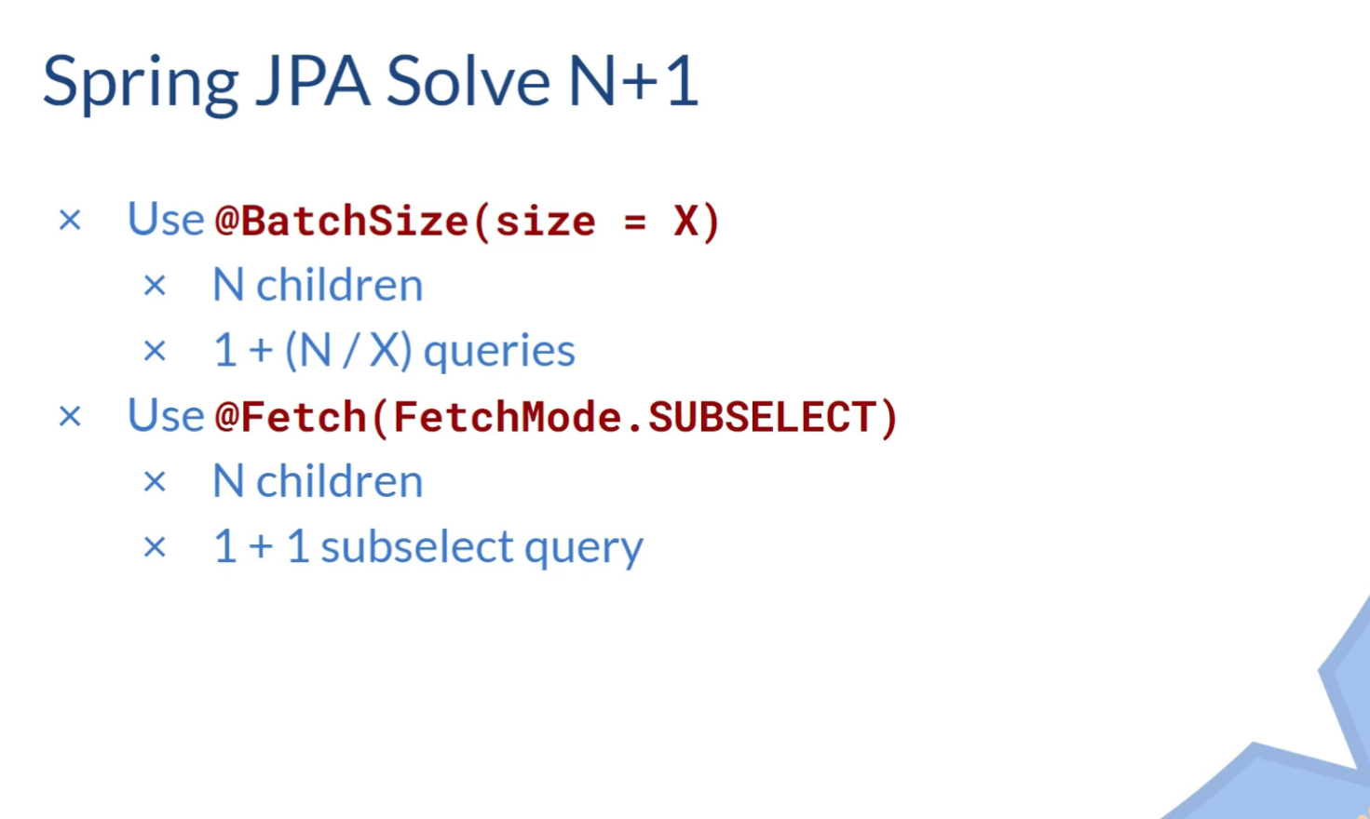
N+1 Problem

Slide 151
N+1 Problem
SELECT *
FROM authors;
-- pretend this returns 3 authors
SELECT *
FROM books
WHERE author_id in (1, 2, 3); -- an array of the author's ids

Slide 152
N+1 Problem
{
query {
authors {
name
books {
title
}
}
}
}

Slide 153
N+1 Problem
schema = `{
type Query {
authors: [Author]
}
type Author {
id: Int
name: String
books: [Book]
}

Slide 154
N+1 Problem
type Book {
id: Int
title: String
}
}`

Slide 155
N+1 Problem
resolvers = {
Query: {
authors: async () => {
return ORM.getAllAuthors()
}
}
Author: {
books: async (authorObj, args) => {
return ORM.getBooksBy(authorObj.id)
}
},
}

Slide 156
N+1 Problem
SELECT *
FROM authors;
SELECT *
FROM books
WHERE author_id in (1);
SELECT *
FROM books
WHERE author_id in (2);
SELECT *
FROM books
WHERE author_id in (3);

Slide 157
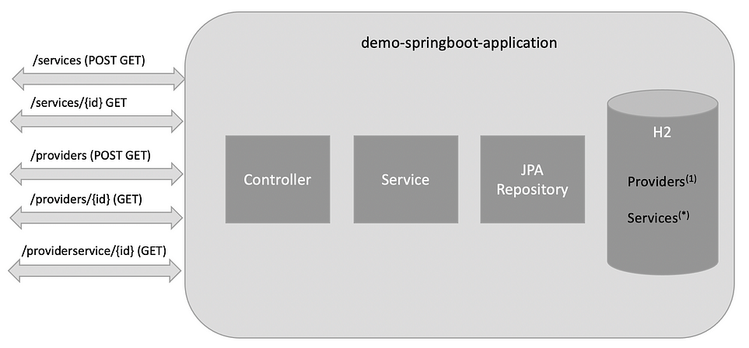
Data Loader

Slide 158
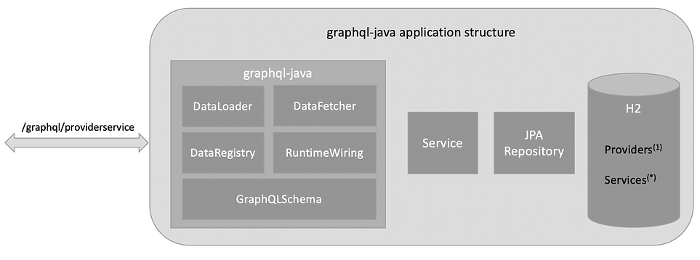
Data Loader

Slide 159
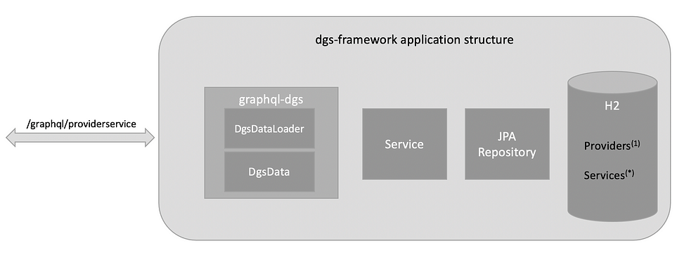
Data Loader

Slide 160
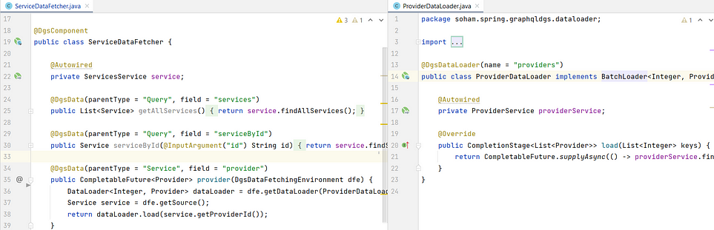
Data Loader

Slide 161
Nestjs
Nest (NestJS) is a framework for building efficient, scalable Node.js server-side applications.
It uses progressive JavaScript.
It is built with and fully supports TypeScript (yet still enables developers to code in pure JavaScript).
It combines elements of OOP (Object Oriented Programming), FP (Functional Programming), and FRP (Functional Reactive Programming).

Slide 162
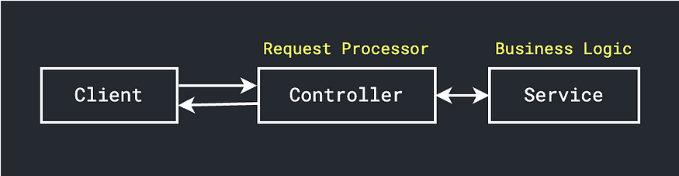
Nestjs

Slide 163
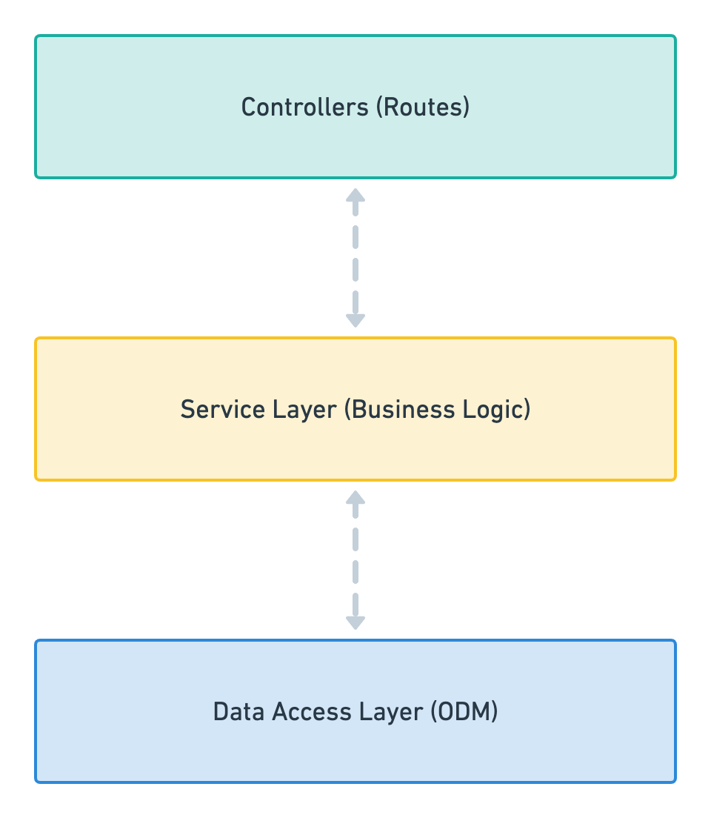
Nestjs

Slide 164
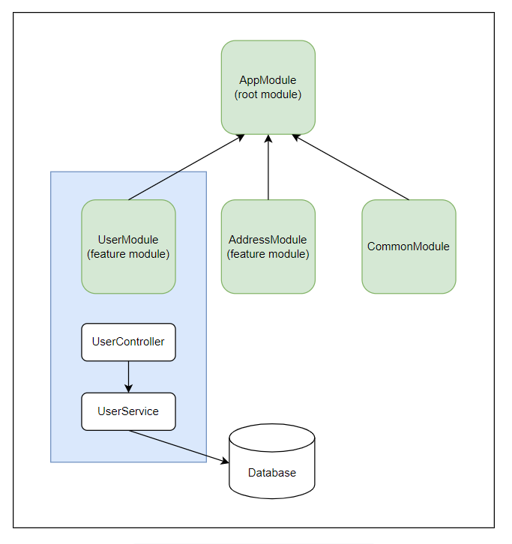
Nestjs

Slide 165

Nestjs

Slide 166

Nestjs

Slide 167
Nestjs
It uses TypeScript and Node.js.
That's why Nest is compatible with both TypeScript and pure JavaScript.
Nest takes advantage of the latest language features, so to use it with vanilla JavaScript we need a Babel compiler.
Prerequisites#
Make sure that Node.js (>= 10.13.0, except for v13) is installed on your operating system.

Slide 168

Nestjs

Slide 169
Nestjs
Nest aims to be a platform-agnostic framework.
Platform independence makes it possible to create reusable logical parts that developers can take advantage of across several different types of applications.
Technically, Nest can work with any Node HTTP framework once an adapter is created.
There are two HTTP platforms supported out-of-the-box: express and fastify.
You can choose the one that best suits your needs.

Slide 170

Nestjs

Slide 171
Nestjs - Installation
$ npm i -g @nestjs/cli
$ nest new project-name
Alternative
$ git clone https://github.com/nestjs/typescript-starter.git project
$ cd project
$ npm install
$ npm run start

Slide 172

Nestjs - Installation

Slide 173

Nestjs - Installation

Slide 174

Nestjs - Installation

Slide 175

Nestjs - Installation

Slide 176
Nestjs – Installation – Third Approach
$ npm i --save @nestjs/core @nestjs/common rxjs reflect-metadata

Slide 177
Nestjs
Running the application#
Once the installation process is complete, you can run the following command at your OS command prompt to start the application listening for inbound HTTP requests:
$ npm run start
$ npm run start:dev

Slide 178

Controllers

Slide 179
Routing
@Controller() decorator, which is required to define a basic controller.
Optional route path prefix ‘/customers’.
Using a path prefix in a @Controller() decorator allows us to easily group a set of related routes, and minimize repetitive code.
For example, we may choose to group a set of routes that manage interactions with a customer entity under the route /customers.

Slide 180

Routing

Slide 181
Providers
Providers are a fundamental concept in Nest.
Many of the basic Nest classes may be treated as a provider – services, repositories, factories, helpers, and so on.
The main idea of a provider is that it can be injected as dependency; this means objects can create various relationships with each other.
The function of "wiring up" instances of objects can largely be delegated to the Nest runtime system.

Slide 182

Providers

Slide 183

Providers

Slide 184

Modules

Slide 185

Modules

Slide 186

Modules

Slide 187

Middleware
Middleware is a function which is called before the route handler. Middleware functions have access to the request and response objects, and the next() middleware function in the application’s request-response cycle. The next middleware function is commonly denoted by a variable named next.

Slide 188

Exception Handlers

Slide 189
Built-in pipes
ValidationPipe
ParseIntPipe
ParseFloatPipe
ParseBoolPipe
ParseArrayPipe
ParseUUIDPipe
ParseEnumPipe
DefaultValuePipe

Slide 190

Guards

Slide 191
Nestjs Graphql
# install the required packages
$ yarn add @nestjs/graphql @nestjs/apollo graphql apollo-server-express apollo-server-core

Slide 192

Nestjs Graphql

Slide 193

Nestjs Graphql

Slide 194

Nestjs Graphql

Slide 195

Nestjs Graphql

Slide 196

Nestjs Graphql

Slide 197
Swagger
npm install --save @nestjs/swagger swagger-ui-express
Or
npm install --save @nestjs/swagger fastify-swagger

Slide 198
Questions

Slide 199
Module Summary
Spring Integration Framework.
Message, Channel and Adapter
Understood the different Component Integration
Understood the Event-Driven Architecture

